Slide 1
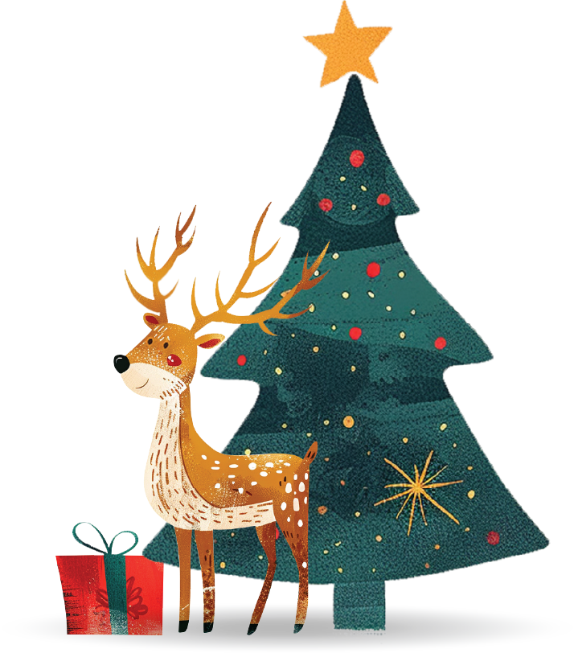
Merry Christmas
Add Your Own Subtitle Here

Slide 2
Today's Topics:
Welcome and Introductions
Gifts and Surprises
A brief overview of what’s to come and a warm welcome to the attendees.
Details on gifts, giveaways, or surprises planned for the audience.
Holiday Highlights
Closing Remarks and Thank You
A look back at the key moments and achievements of the year.
Final thoughts, gratitude, and a reminder to enjoy
the holiday season.
Upcoming Events
An outline of the main events and
celebrations planned for the holiday season.

Slide 3
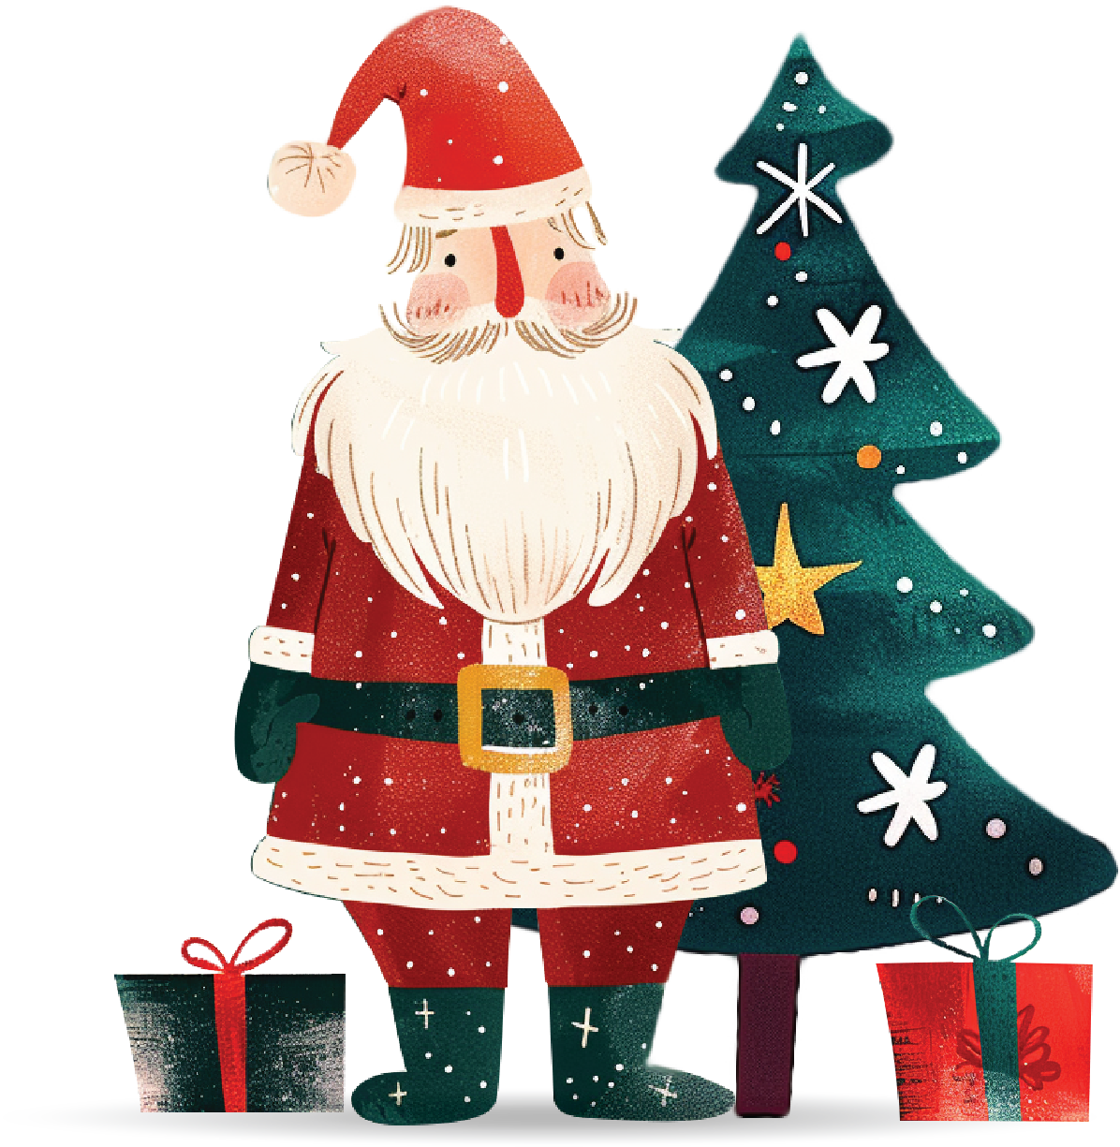
Welcome to the
Holiday Celebration!
Introduce the purpose of the presentation and set the festive tone for your audience. This section is where you can provide a warm welcome, share the objectives of the event, or set the context for what's to come. Keep it light, cheerful, and in line with the holiday spirit!

Slide 4
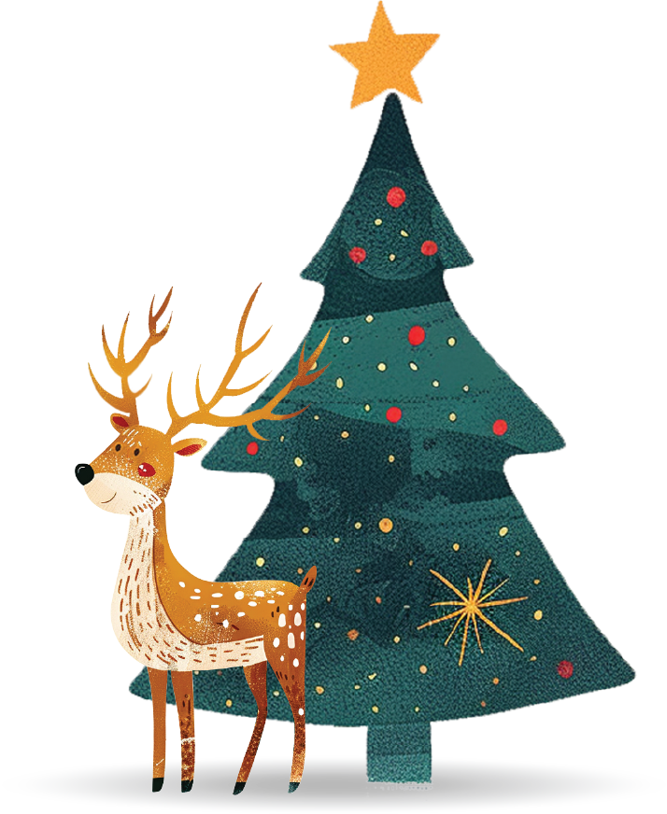
Holiday Spirit
‘’Add a festive quote or message here that captures the spirit
of Christmas.’’

Slide 5
Our Christmas Story
Tell your unique Christmas story here. This could include how your family, team, or community celebrates the season. Highlight memorable moments, traditions, or any special events that make your holiday season meaningful and joyful. Keep it personal and heartfelt to engage your audience.

Slide 6
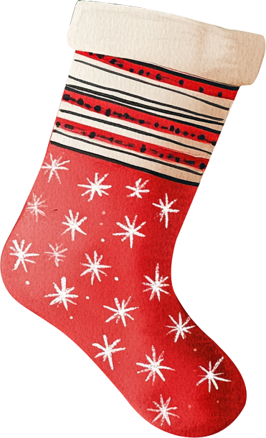
Holiday Highlights
Traditions
Memorable
Moments
Future Plans
Describe key traditions or customs that are important to your Christmas celebrations. This could include decorating the tree, baking holiday treats, or any unique family rituals.
Outline your plans or goals for this holiday season or future celebrations. Include any upcoming events, new traditions you want to start, or wishes for the new year.
Share highlights or memorable moments from past Christmas celebrations. This section can capture stories, special events, or any cherished memories.

Slide 7
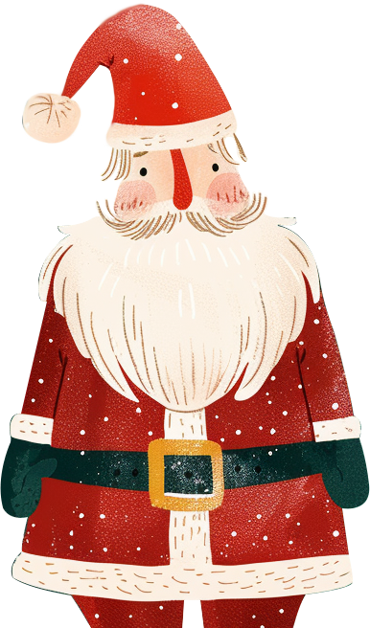
Memorable Moments
Describe this memorable moment. Include why it was special, who was involved, and what made it stand out. Use this space to share a heartwarming story, a funny incident, or a significant event that captures the essence of your holiday celebrations.

Slide 8
Important Dates
1
December 1 - Start of Advent Season
25
December 25: "Christmas Day"
Begin the countdown to Christmas with
the first day of Advent.
The main celebration of Christmas,
commemorating the birth of Jesus Christ.
6
December 6: "St. Nicholas Day"
31
December 31: "New Year's Eve"
A day celebrating St. Nicholas, who inspired the tradition of Santa Claus.
Celebrating the end of the year and
welcoming the new one.
24
December 24: "Christmas Eve"
The night before Christmas, often celebrated with family gatherings and midnight mass.

Slide 9
Christmas Countdown
December 1 - Start of Advent
December 20 - Christmas Party
December 25 - Christmas Day
Begin the festive season with the first
day of Advent, marking the start of
the Christmas countdown.
Host or attend a festive Christmas
party to gather with friends and
family and enjoy holiday cheer.
Celebrate the main event with a festive meal, gift-giving, and time spent with loved ones.
1
20
25
6
24
December 6 - St. Nicholas Day
December 24 - Christmas Eve
Celebrate St. Nicholas Day with small
gifts or treats, a tradition that has
inspired Santa Claus.
A special night for family dinners, exchanging gifts, and preparing for
the Christmas Day celebration.

Slide 10
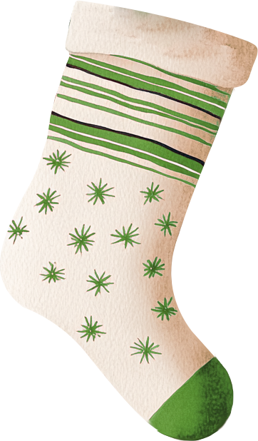
Naughty vs. Nice List
Naughty
Nice
• Missed deadlines
• Forgot to buy gifts
• Skipped family dinner
• Left Christmas lights
on all night
• Didn't send holiday
cards
• Helped decorate
the tree
• Sent gifts on time
• Attended all family
events
• Baked cookies for
neighbors
• Donated to charity

Slide 11
Holiday Expenses
30%
Chart Placeholder (Bar or Pie Chart)
20%
Insert a bar or pie chart here to visualize your holiday expenses. Include
categories like Gifts, Travel, Food, Decorations, and Charitable Donations.
This helps to see where most of the budget is allocated and identify
areas to optimize.
15%
25%
30% Charitable
Donations
25% Gifts
20% Decorations
10%
15% Travel
10% Food

Slide 12
Christmas Around the World
Country Name 1
Country Name 4
Briefly describe the tradition
Briefly describe the tradition
Country Name 2
Country Name 5
Briefly describe the tradition
Briefly describe the tradition
Country Name 3
Briefly describe the tradition
Country Name 6
Briefly describe the tradition

Slide 13
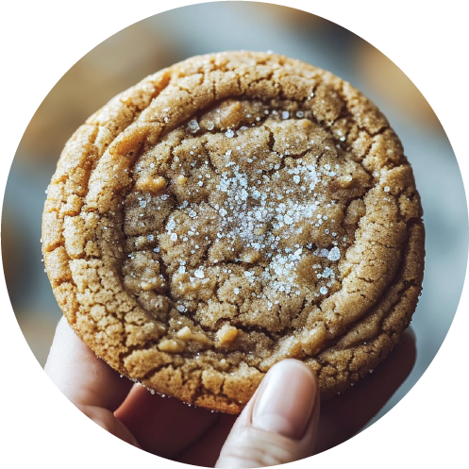
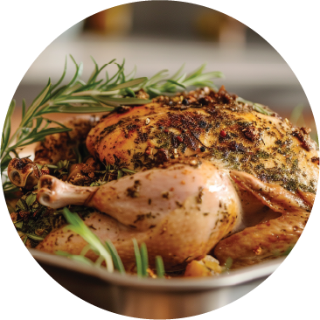
Delicious Christmas Recipes
Classic Gingerbread
Cookies
Roast Turkey
2 ¼ Cups - All-Purpose Flour
1 Cup - Confectioner's Sugar
½ Cup - Granulated Sugar
½ Cup - Butter (softened)
½ Cup - Molasses
2 Tablespoons - Milk
1 ½ Teaspoons - Ground Cinnamon
1 Teaspoon - Baking Powder
1 Teaspoon - Ground Ginger
½ Teaspoon - Ground Cloves
½ Teaspoon - Baking Soda
½ Teaspoon - Salt
¼ Teaspoon - Nutmeg (grated)
1 - Egg
1 12-Pounds - Fresh Turkey
Add - Kosher Salt
Add - Black Pepper (freshly ground)
1 Large bunch -Fresh Thyme
1 - Lemon (halved)
1 - Spanish Onion (quartered)
1 Head - Garlic (halved crosswise)
4 Tablespoons - Unsalted Melted Butter (1/2 stick)

Slide 14
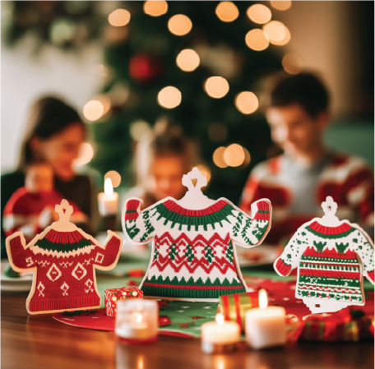
Image Gallery
Photo Title
Photo Title
Photo Title
Photo Title
Photo Title

Slide 15
2028
Large Number (e.g., 2028) With a Short Description.

Slide 16
Meet the Elves
James Johnson
Sarah Moore
Michael Brown
James responsible for keeping Santa’s reindeer in top shape. With a gentle touch and a firm hand.
Known for her creativity and
attention to detail, she ensures every toy is made with care and a touch of magic.
Michael is the master of gift
wrapping, turning every present into a work of art.

Slide 17
Holiday Wishes
Christmas is the time when all the magic happens. The joy of seeing my family together, the laughter, and the shared moments are the best gifts of all.
There’s something special about the holiday spirit. From decorating the tree to the smell of freshly baked cookies, it’s a time that brings warmth to my heart.
Emily S.
Michael R.

Slide 18
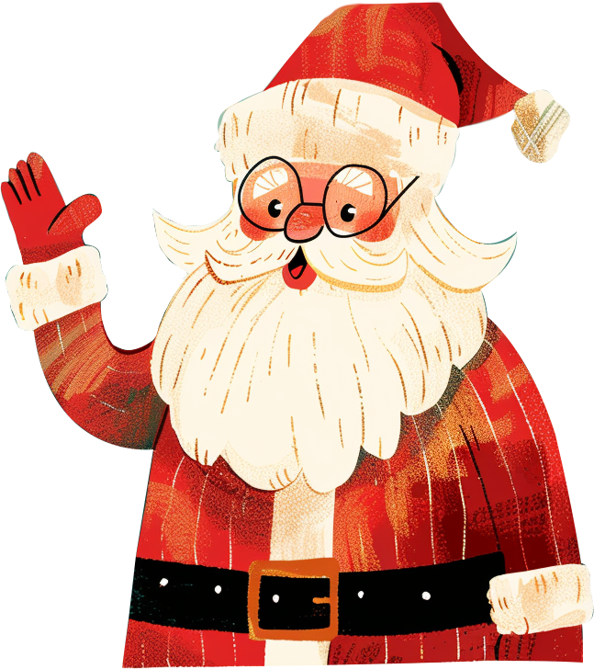
Happy Holidays!
Thank you for joining us today!
We hope you enjoyed our holiday presentation and found some inspiration for your own
celebrations
With Best Wishes, Your Team

Slide 19
Stay in Touch
Have any questions? Please contact us:
+1-013-4576-890
businessroadmaptemplate@mail.ltd
businessroadmaptemplate.ltd

Slide 20
Happy Holidays
and Farewell!

