Slide 1
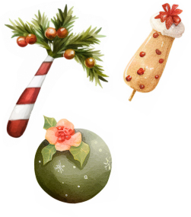
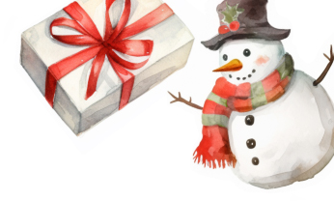
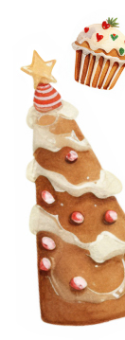
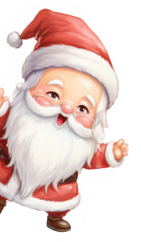
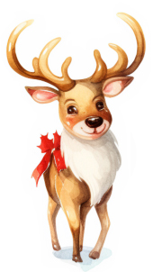
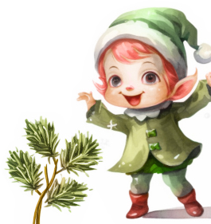
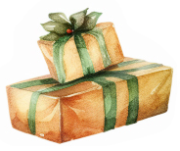
Jingle
Mingle
&
JOIN US FOR A
CHRISTMAS PARTY
SATURDAY
18
DECEMBER
7: 00 pm at the Anderson’s home
12345 HAPPY WAY | LOS ANGELES, CA RSVP TO JESSICA AT 123-456-7890
PLEASE BRING A SECRET SANTA GIFT TO SHARE

