Slide 1



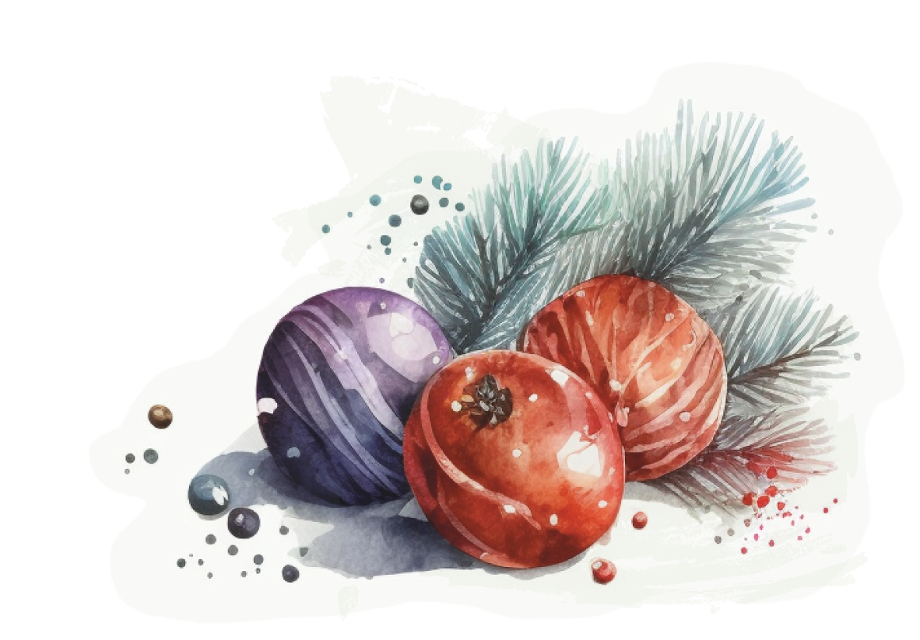
Merry Christmas
Mathias
This gift voucher entitles you to
A DAY AT A
THEME PARK
On a date of your choice
Love from Santa

