Slide 1
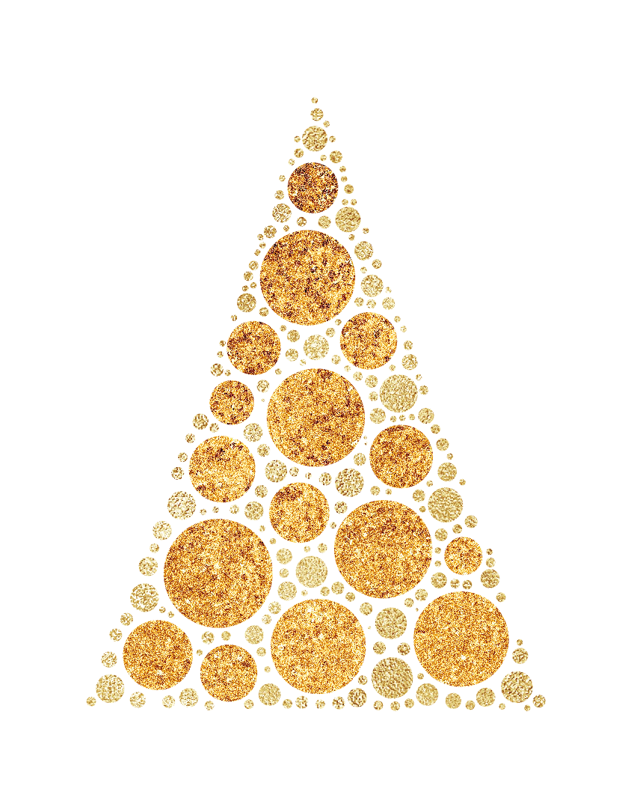

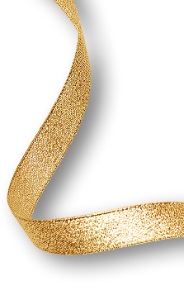




We warmly
INVITE YOU
Saturday
DEC 25
DJ Santa
Sam Snow
Open 9:00 pm • Guest list only • Entry $12
JINGLE BELLS HOTEL & BAR
333 Wrigley Drive, Lake Geneva, WI 53147

Slide 2

We warmly
INVITE YOU
Saturday
DEC 25
DJ Santa
Sam Snow
Open 9:00 pm • Guest list only • Entry $12
JINGLE BELLS HOTEL & BAR
333 Wrigley Drive, Lake Geneva, WI 53147

