Slide 1
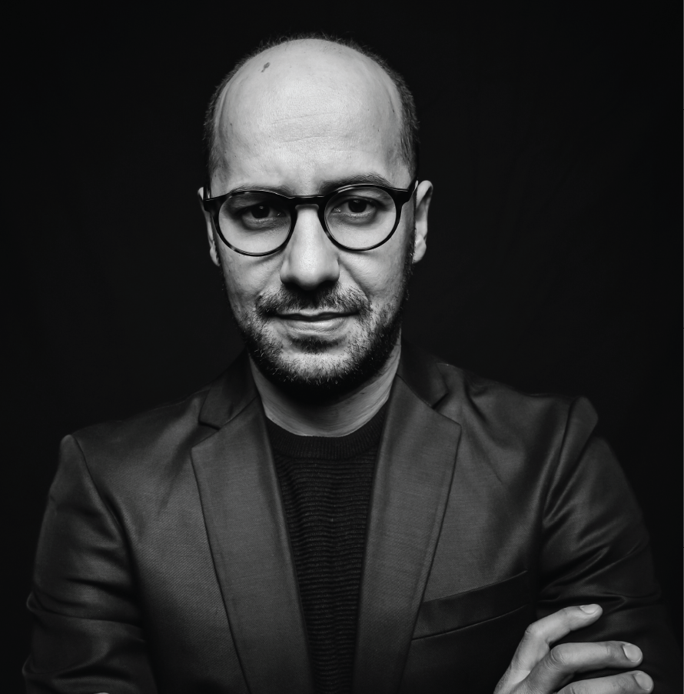
In loving memory of
Daniel Adams
December 1986 - January 2020
10:00 AM
123 Anywhere St. Any City, ST 12345

Slide 2
Obituary
Nam aliquam sit amet velit sed mattis. Donec sollicitudin dictum nisl, a cursus neque fermentum vel. Sed pretium rutrum velit ac placerat. Etiam in sem ut urna lacinia euismod eu quis dolor. In in lorem nunc. Cras sit amet est libero
Pallbearers
Matt Zhang
Morgan Maxwell
Murad Naser
Order Of Service
Scripture Reading
Praise & Worship
Opening Prayer
Sunday Message
Love Offering
Linda Marshall
Music Ministry
Jeffrey Morgan
Congregation
Steve Robertson

