Slide 1

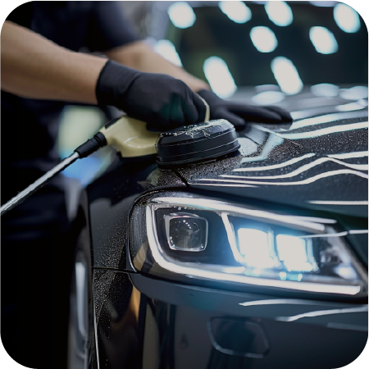
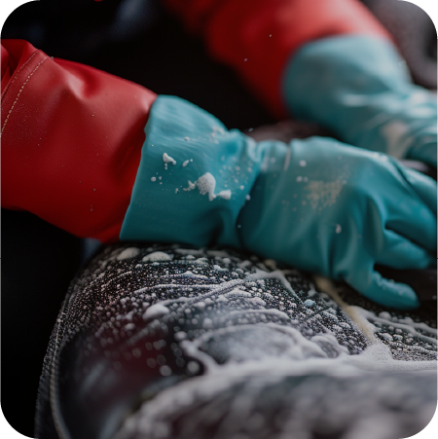
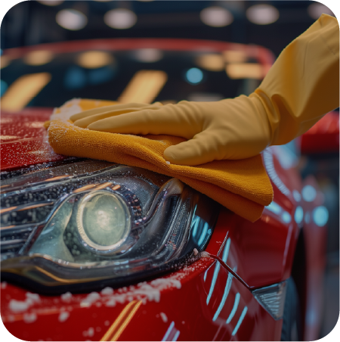
CAR WASH
Price List
Membership
Packages:
Start at
$30/month
Basic Wash | Starting at $10
- Exterior wash
- Tire shine
Standard Wash | Starting at $20
- Basic wash services
- Interior vacuuming
- Window cleaning
Deluxe Wash | Starting at $40
- Standard wash services
- Hand wax
- Interior surface cleaning
Premium Wash | Starting at $60
- Deluxe wash services
- Clay bar treatment
- Interior detailing
Additional Services:
- Upholstery shampooing: $20
- Carpet cleaning: $15
- Engine bay cleaning: $25
Call Now: +1-012-345-7996 | 47263 Borer Bypass Suite 489 | www.site.ltd

