Slide 1
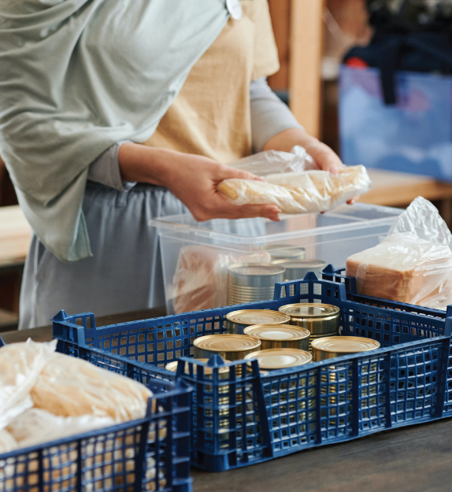
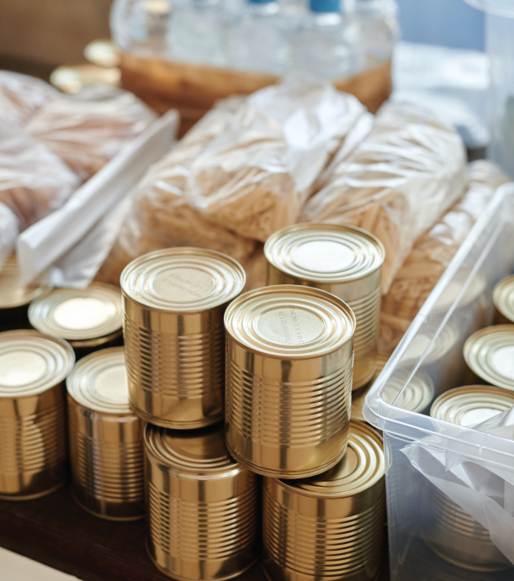
Join in Campaign
FOOD DRIVE
People Should
Help Each Other!
Food is a human right and is an immediate and tangible way to help someone every donation of
food can make a difference.
October 6, 2024
Most Needed Items:
Canned fish, canned corn, beans,
canned meat, chicken, pork,
beef, canned asparagus.
Drop Location:
123 anywhere st., any city
Louisiana, 33131
Contact: + 123-456-7890
Example@mail.com
www. yourwebsite.com

