Slide 1
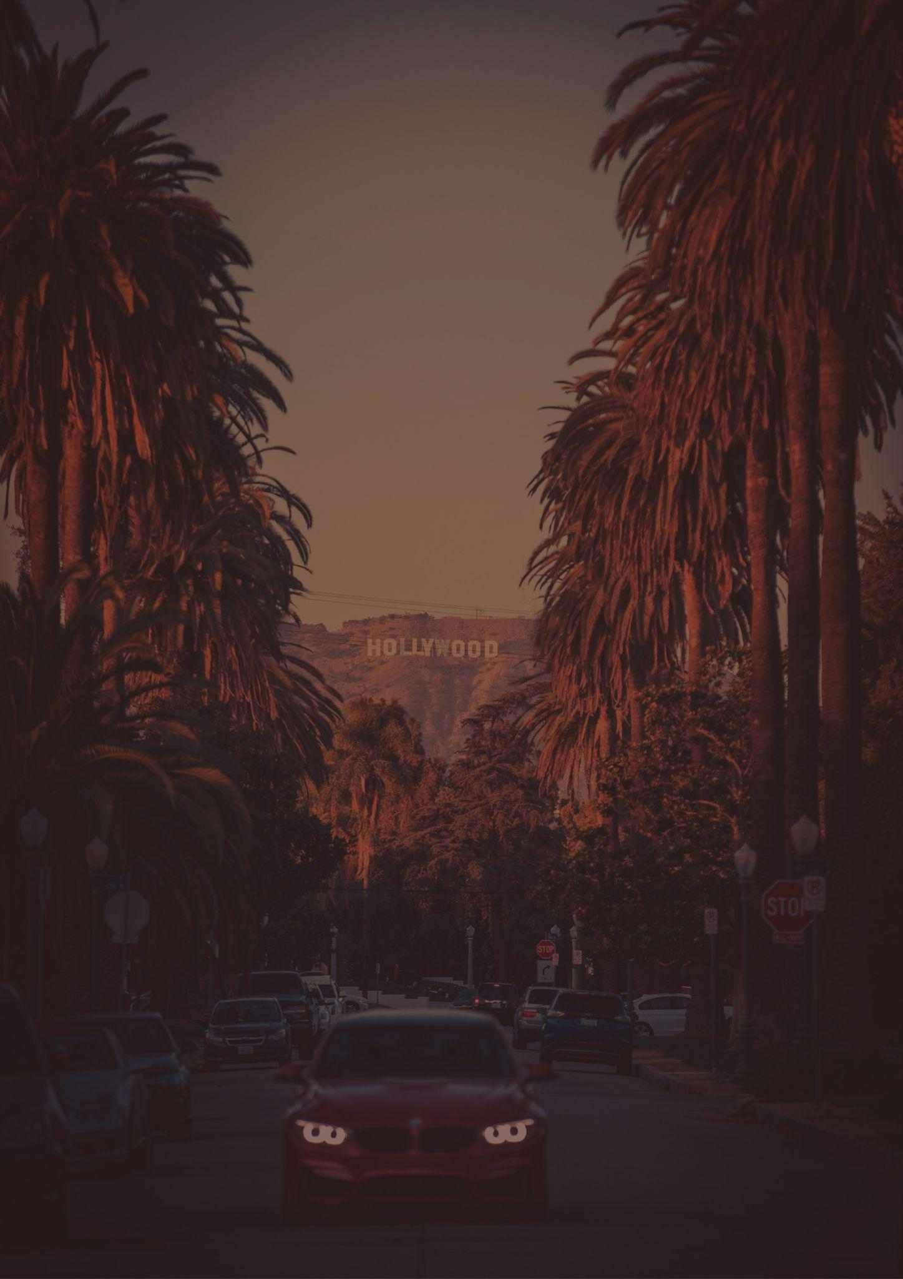
CALIFORNIA
Travel bucket list
HOLLYWOOD
DEATH VALLEY NATIONAL PARK
SAN FRANCISCO
OUE SKYSPACE
GOLDEN GATE BRIDGE
Santa Cruz VINEYARDS
YOSEMITE NATIONAL PARK
Malibu Surfrider BEACH
DISNEYLAND
WINCHESTER MYSTERY HOUSE
DEATH VALLEY PARK
SAN DIEGO ZOO
KINGS CANYON PARKS
ALCATRAZ ISLAND
SEQUOIA PARKS
SOLVANG
REDWOOD PARKS
LASSEN VOLCANIC PARK
JOSHUA TREE PARK
LAKE TAHOE
HEARST CASTLE
RMS QUEEN MARY
SANTA CATALINA ISLAND
SF CABLE CAR MUSEUM
CHANNEL ISLANDS PARK
GLASS BEACH
DESERT HOT SPRINGS
PRESIDIO OF SANTA BARBARA
OLD SACRAMENTO
FISHERMAN’S WHARF

