Slide 1
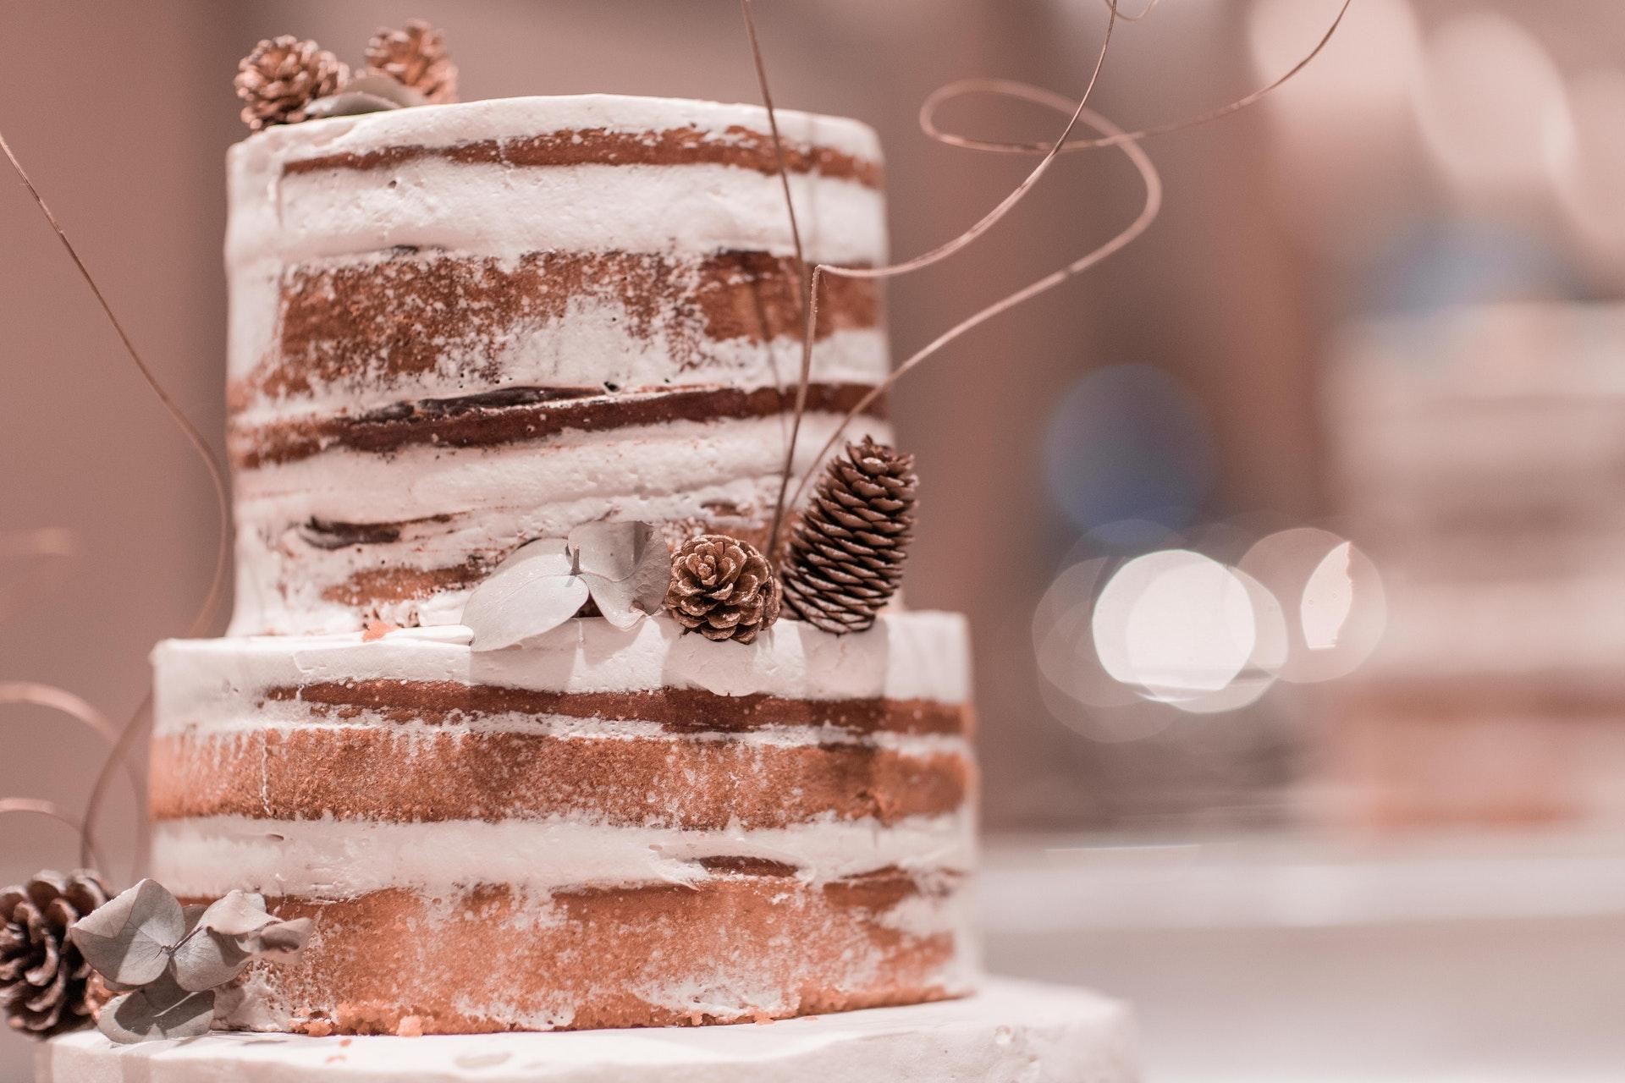
Cake
Business Card
The Best Confectionery

Slide 2
Rosetta
Hermann
Mobile: 012-345-6789
Website: example.com
Email: example@mail.com
Address: 5703 Rippin Crescent
Apt, Bilzen 57073-7014
Pastry Chef

