Slide 1
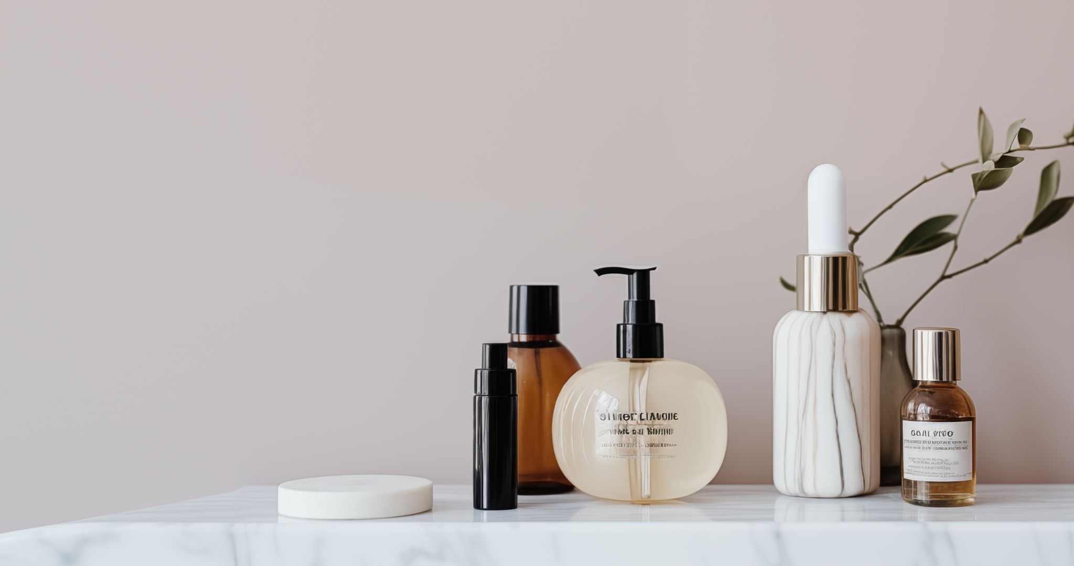
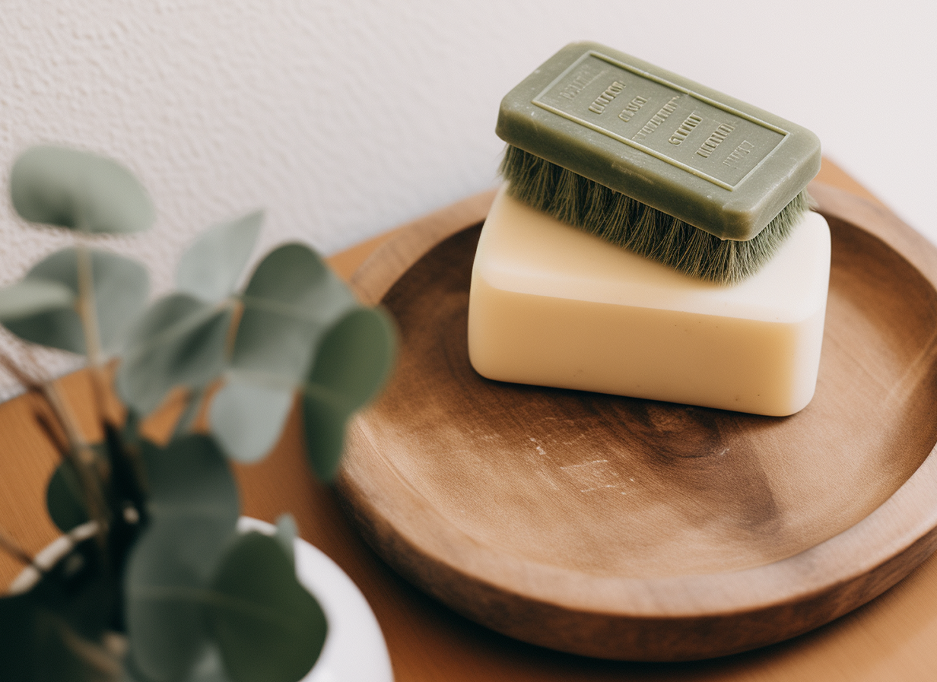

Elevate Your Beauty Routine
Handcrafted Skincare Elegance
Elegance
Charm
Nature's Elegance in Every Drop
Our handcrafted skincare collection is a celebration of nature's bounty. Each product is meticulously curated using the finest botanical extracts, essential oils, and nourishing ingredients. We believe in the power of simplicity, letting the pure goodness of nature enhance your skin natural radiance.
Sustainability in Every Step
Crafted with Care, Made for You
We are committed to a greener, cleaner future. Our packaging is eco-friendly, and our ingredients are responsibly sourced. With Elegance Charm, you not only invest in your beauty but also contribute to the well-being of our planet. Our packaging is eco-friendly, and our ingredients are responsibly sourced.
Our artisans pour their passion and expertise into every batch, ensuring that each product is a testament to quality and authenticity. Say goodbye to mass-produced skincare and embrace the personalized touch formulations. Feel the difference as your skin revels in the care it truly deserves.
EXCLUSIVE OFFERS
FOR OUR CUSTOMERS
SAVE THE DATE -
EXCLUSIVE WORKSHOP
Exclusive 15% discount on your next purchase. Use
voucher code "HANDCRAFTEDJOY" at checkout.
Curious to learn more about the art of crafting
skincare? Workshop on 10.12.24
More Information
+1 (555) 123-4567
www.elegancecharm.com
@elegance_charm

