Slide 1
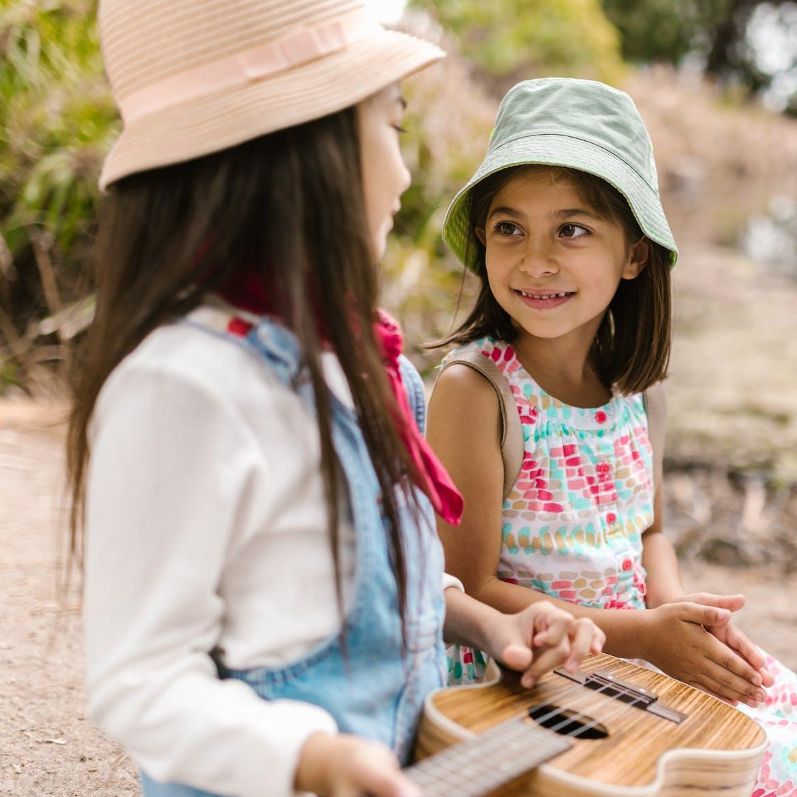
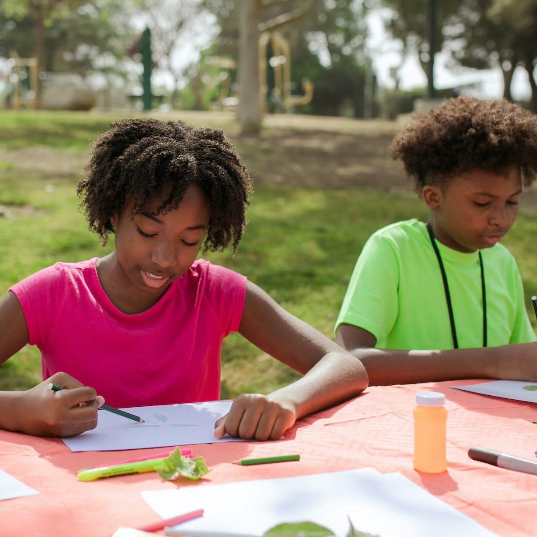
WELCOME
CHILDREN'S SPRING
FESTIVAL
Welcome to the Children's Spring Festival, a joyful celebration of the season filled with laughter, games, and delightful activities for kids of all ages.
Blooming Fun for Every Little One
Join Us On
[Date] from [Time] at [Location]
CONTACT US:
Organizer's contact information
for inquiries.
+1 615-618-2559
SpringFestival@mail.com
SpringFestival.com
261 Green Street, North Little Rock, Arkansas, North Little Rock

Slide 2
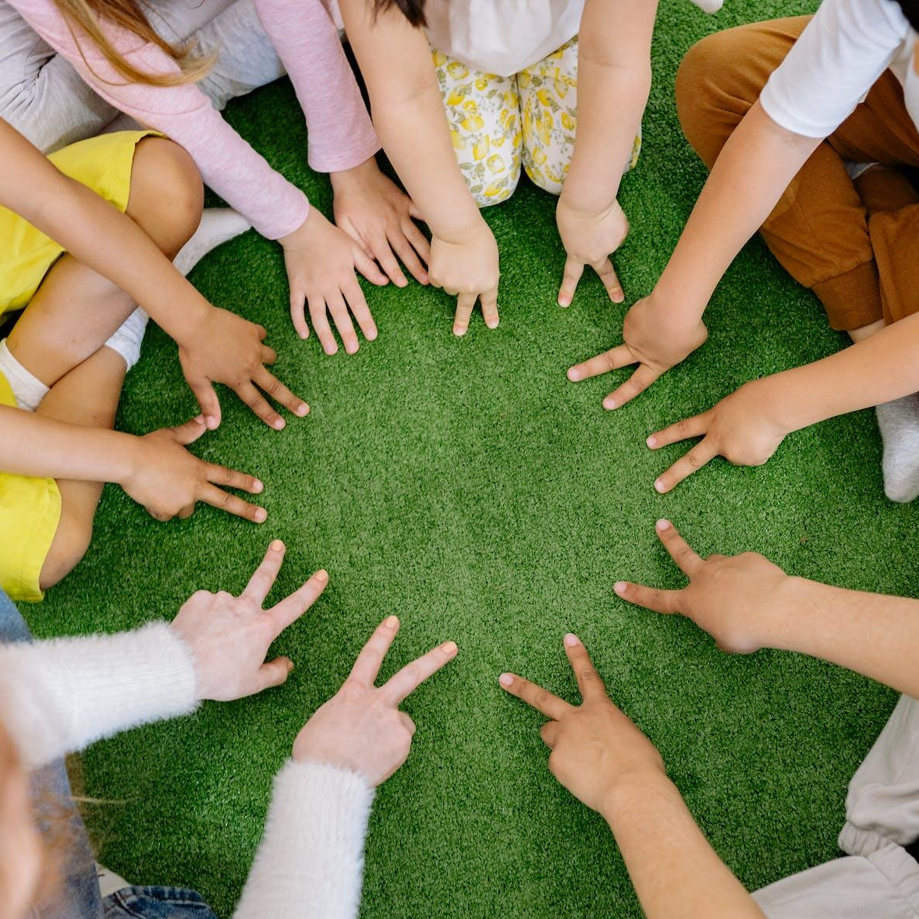
WHY
ATTEND
HAVE FUN
ACTIVITIES
Interactive Workshops:
Community Spirit:
• Arts and crafts, face painting, and
DIY flower planting.
• Come together with families from the community to celebrate the beauty of spring.
Stage Performances:
• Live shows, puppetry, and a magical storyteller.
Safe and Enjoyable:
• Our festival is designed with the safety and enjoyment of your little ones in mind.
Games and Contests:
• Egg hunts, sack races, and a costume contest.
Free Admission:
• Join the fun at no cost! Donations are welcome to support community initiatives.

