Slide 1
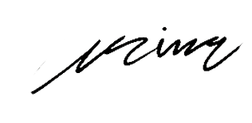
N
C
NEXACORE
SOLUTIONS
Phone:
To: Ava Brooks
+1 (555) 987-4567
Social Responsibility Director
26 July 2024
Email:
Nexacore@mail.com
Dear Ava Brooks
Subject: [Brief Description or Purpose of the Letter]
I trust this letter finds you in good health. On behalf of the Board of Directors of [Organization Name], I am writing to share important updates and insights related to our ongoing efforts and strategic initiatives.
[Explain the purpose of the letter, share updates, strategic decisions, achievements, or future plans of the organization.]
We believe in the power of collaboration, and your role as a valued partner is instrumental to our shared success. Should you have any questions or require further clarification, please do not hesitate to reach out to us. You can contact us at [Phone Number] or [Email Address].
Thank you for your continued support, trust and participation. Together we build the future.
Web:
nexacoresolutions.com
Address
43 Main St. Suite 29
BOARD OF DIRECTORS
Emily Parker
Position: Vice Chair
Robert Hughes
Position: CEO & Director
Laura Mitchell
Position: CFO & Director
Michael Turner
Position: Marketing Director
William Adams
Best regards,
Position: Operations Director
Grace Mitchell
Laura Mitchell
Position: Innovation Director
CEO & Director

