Slide 1
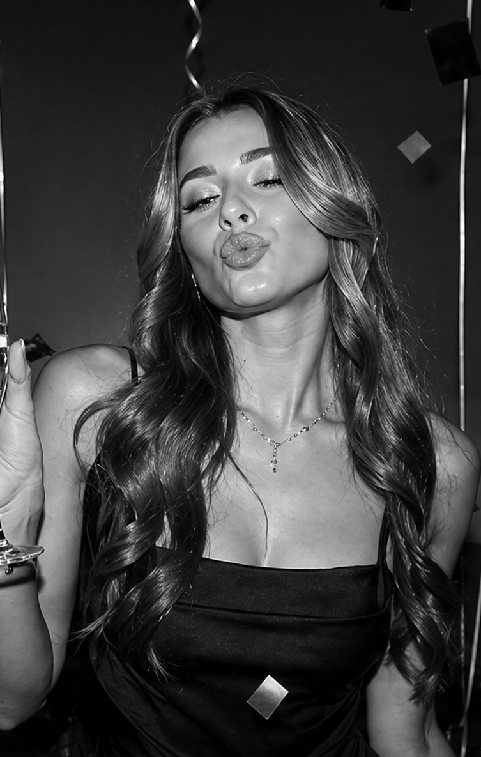
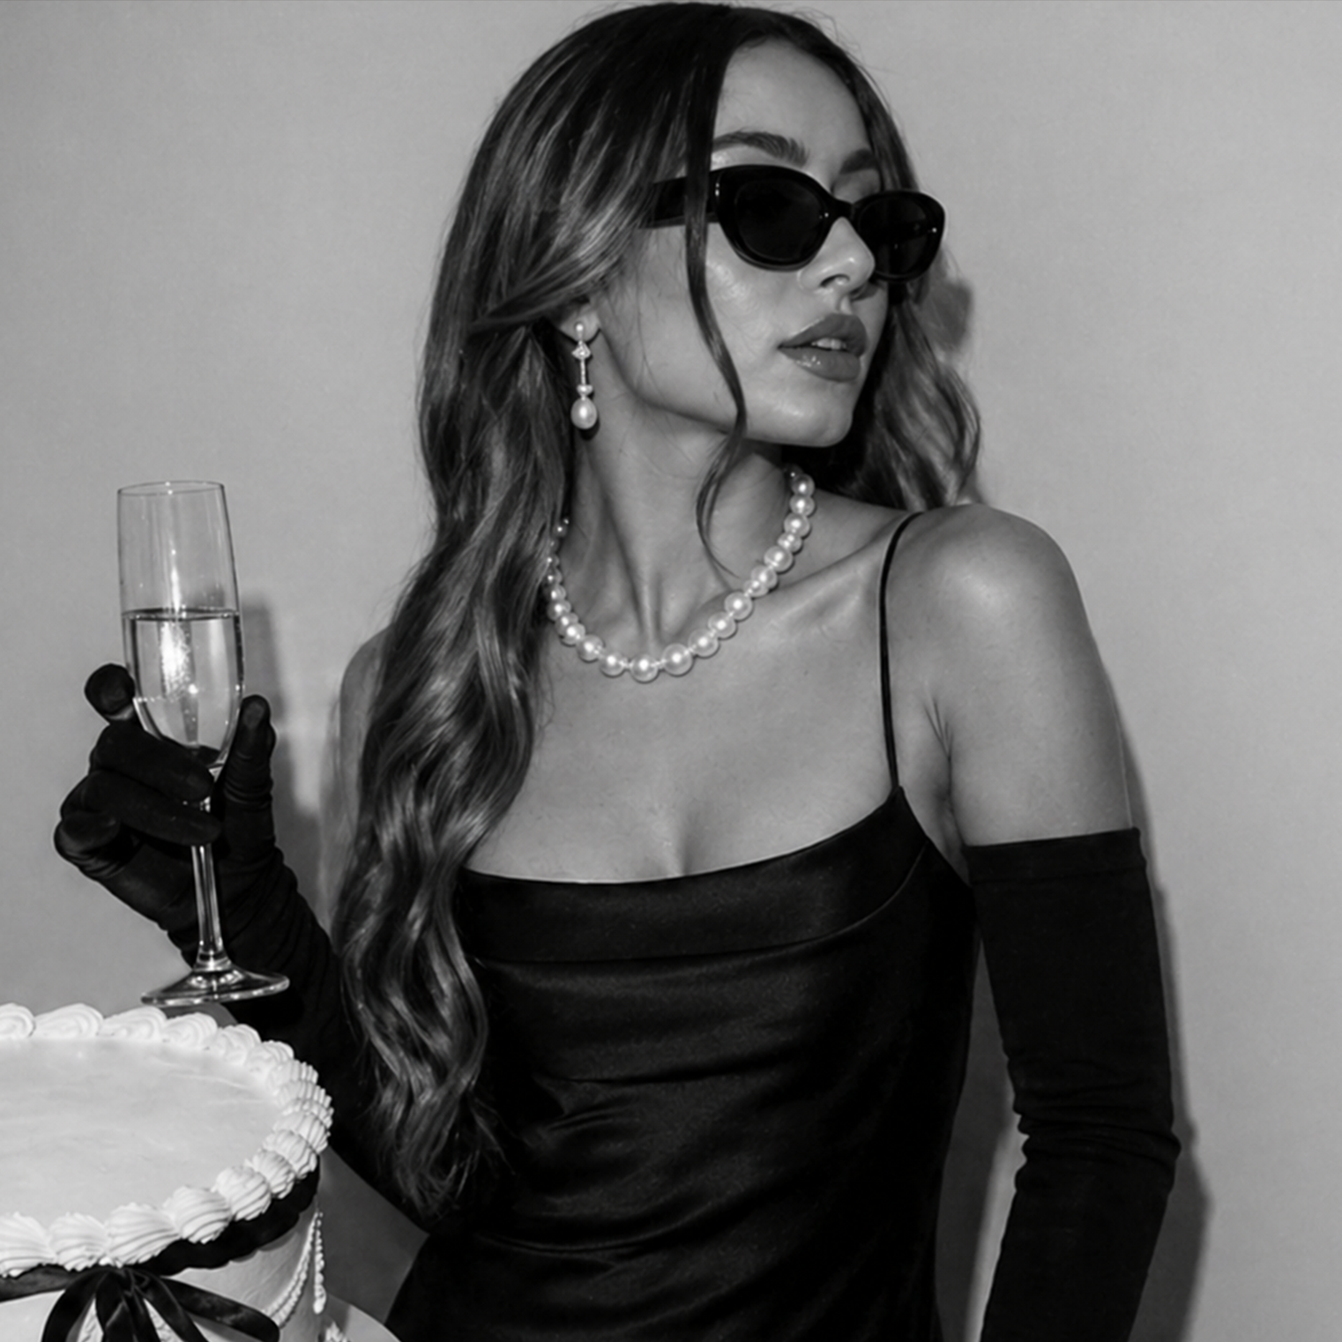
Vol. 1 — Friday, December 24, 2027 — Chicago, IL
Vol. 1 — Friday, December 24, 2027 — Chicago, IL
HAPPY BIRTHDAY
The Celebration Post
It's time to celebrate
EMMA IS TURNING 25!
Here’s to a wonderful year ahead
25 never looked so bright
Join us for an evening full of music, laughter, and unforgettable moments. Expect great vibes, delicious treats, and a dance floor you won’t want to leave.
We’ve prepared a night to remember - and it wouldn’t be the same without you.
Feel free to bring your best energy and your favorite people.
Get ready for an unforgettable celebration filled with great company, fun moments, and memories we'll be talking about long after the night ends.
24
Let’s celebrate!
December

Slide 2


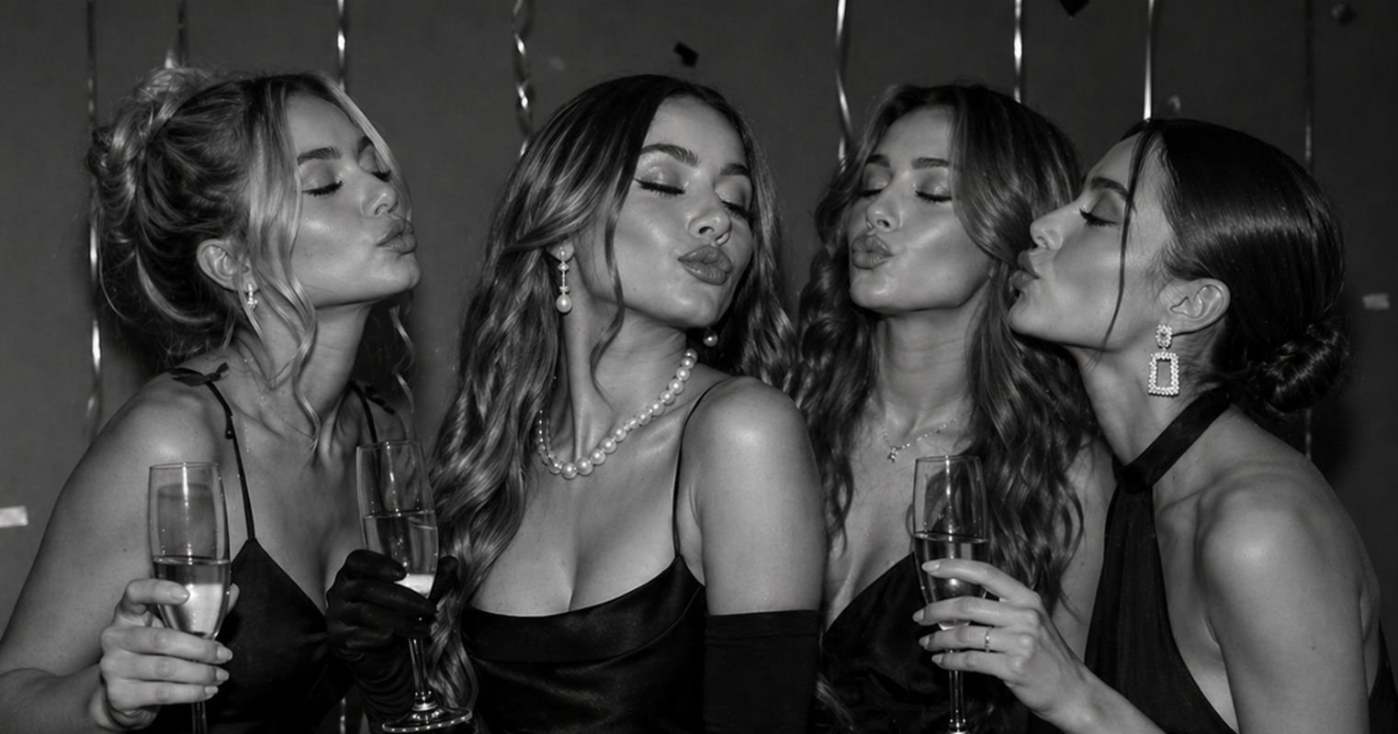
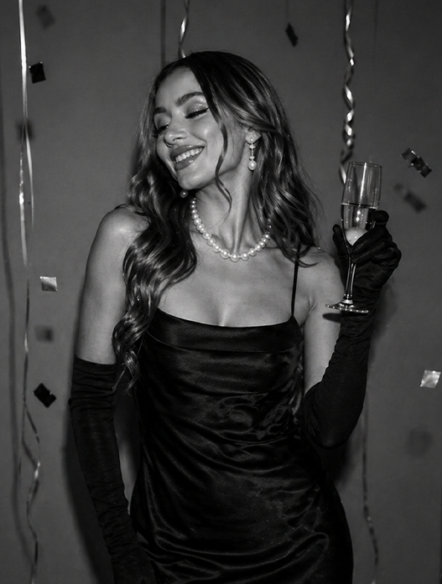
Vol. 1 — Friday, December 24, 2027 — Chicago, IL
Vol. 1 — Friday, December 24, 2027 — Chicago, IL
THE CELEBRATION POST
THE CELEBRATION POST
A NOTE FROM
FAVORITE THINGS
TO DO AT 25
Olivia
Weekend brunch with iced lattes and endless conversations
There are moments in life that deserve a little extra sparkle, and this is definitely one of them. Today is all about laughter, unforgettable memories, and celebrating someone truly special.
From spontaneous adventures to quiet late-night talks, every memory we’ve shared has been filled with warmth and joy. You have a way of making ordinary days feel extraordinary, and that’s something rare.
From spontaneous adventures to quiet late-night talks, every memory we’ve shared has been filled with warmth and joy. You have a way of making ordinary days feel extraordinary.
May this year bring you even more reasons to smile, new dreams to chase, and beautiful surprises along the way.
Sending all my love today and always.
Cozy evenings with movies and homemade desserts
Trying new creative hobbies like painting or photography
Planning trips to places never
visited before
Hugs & cheers,
Olivia
Discovering hidden cafes around
the city
Happy Birthday Word Search
Smile
Friends
Joy
Celebrate
Cake
Party
Magic
Dreams
Wish
Love
S
F
D
C
A
K
E
M
A
G
I
C
M
R
R
E
G
J
P
N
S
Q
O
A
I
I
E
L
H
U
A
B
D
W
P
K
L
E
A
E
J
Y
R
V
F
E
L
E
E
N
M
B
K
T
T
C
G
R
K
D
X
D
S
R
L
R
Y
X
H
T
J
R
Q
S
Y
A
O
E
Z
Z
J
Y
H
E
T
A
W
T
V
W
X
A
K
U
G
A
R
K
L
E
E
Q
C
Q
L
I
F
M
P
J
V
O
P
A
S
S
I
H
M
S
L
O
Y
U
R
T
Y
J
K
O
L
E

