Slide 1
black
history
month
YOUR PRESENTATION STARTS HERE

Slide 2
Content of the Presentation
01
02
03
Introduction
& Origins
Key Historical
Figures
Historical
Movements
and Achievements
04
05
06
Cultural
Contributions
Challenges
and Victories
Celebrating
Black History
Month Today

Slide 3
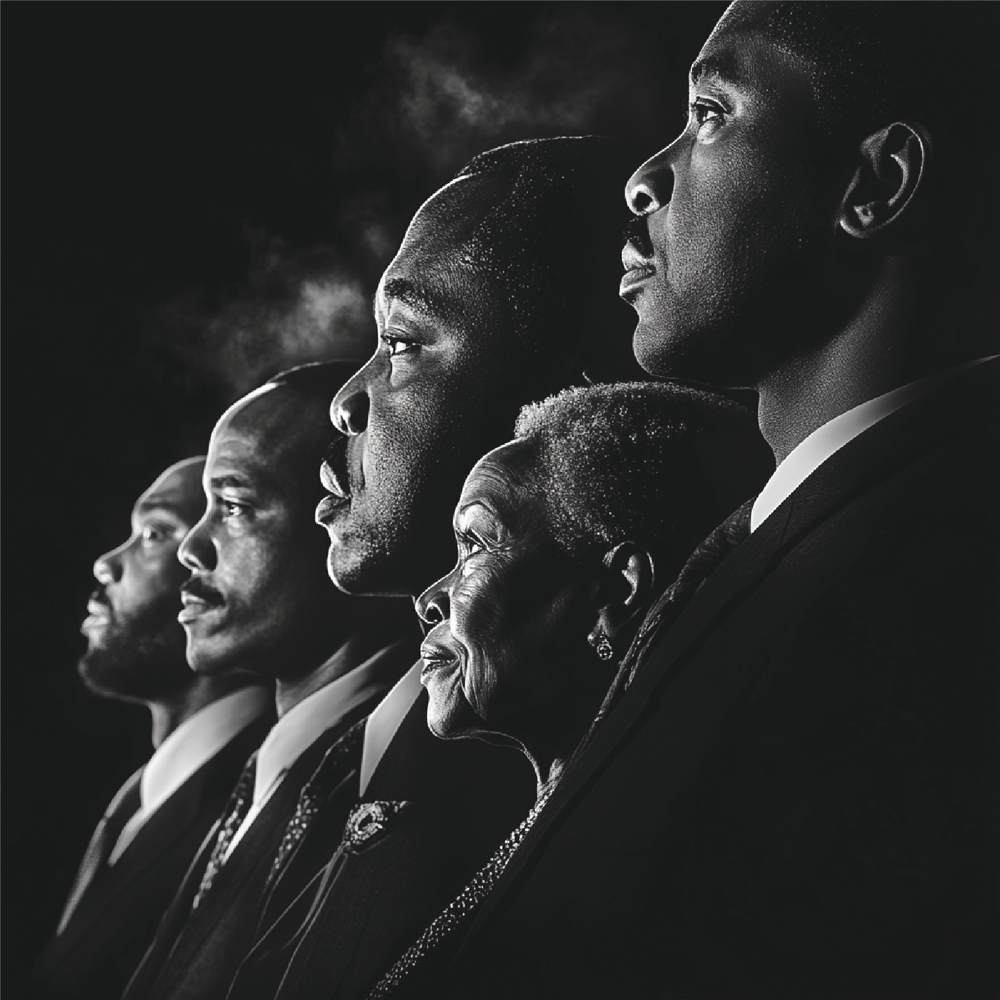
Section 1:
INTRODUCTION
& ORIGINS

Slide 4
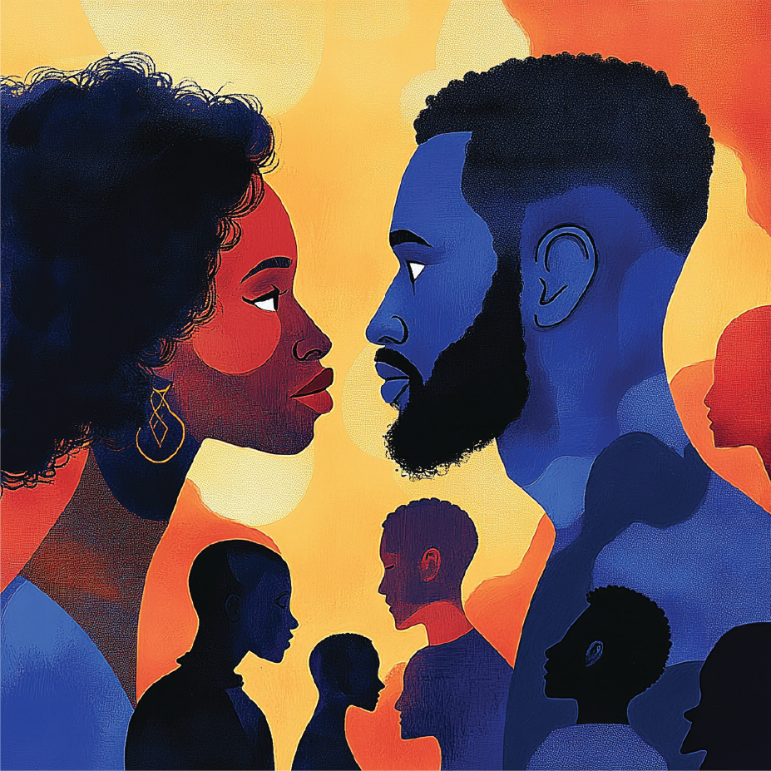
What is Black
History Month?
Tell about this annual event, when it is held, in which countries and provide a general description of the purpose of the event.

Slide 5
Why Do We
Celebrate It?
Talk about the importance of honoring the
achievements and struggles of black people.

Slide 6
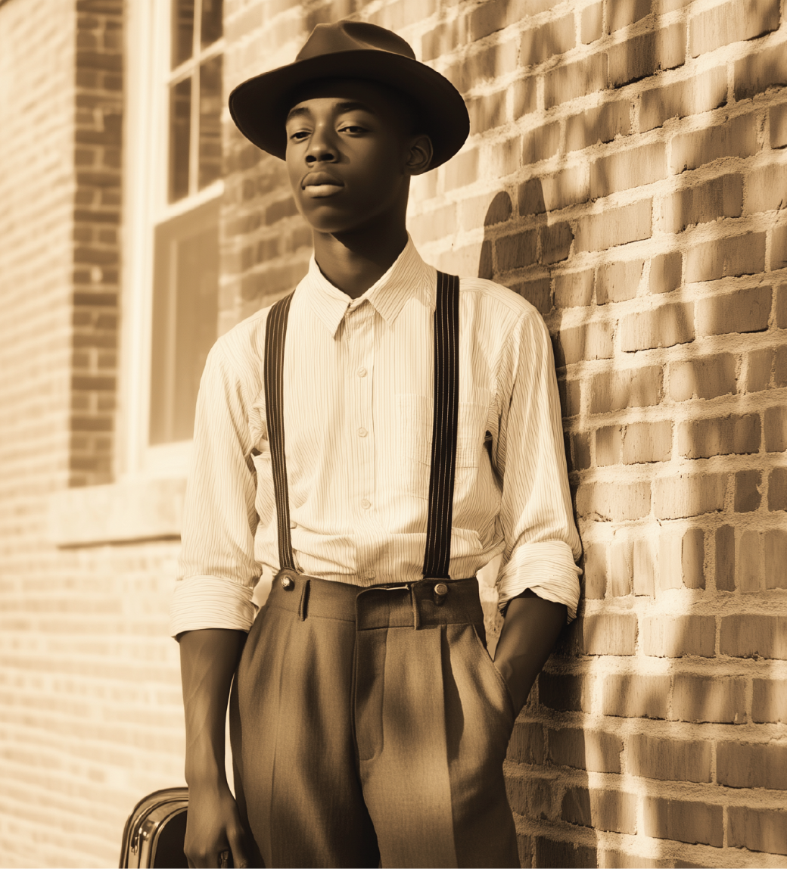
Historical
Background
Tell when people first started
celebrating this event.

Slide 7
When It
Expanded
Tell the audience when and who
expanded this event.

Slide 8
Section 2:
KEY
HISTORICAL
FIGURES

Slide 9
Carter G. Woodson
The Father of Black
History Month
Tell about his vision and contribution
to historical awareness.

Slide 10
Frederick Douglass
and Abolitionism
Tell about his efforts to end slavery
through speaking and activism.

Slide 11
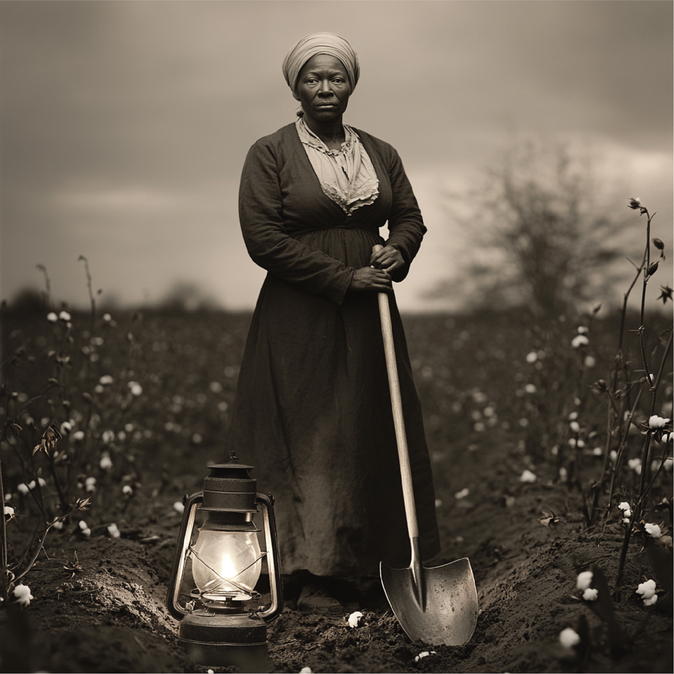
Harriet Tubman
The Underground
Railroad Hero
Tell about this incredible woman,
about her heroic deeds.

Slide 12
Rosa Parks
The Mother of
the Civil Rights
Movement
Remember her role in the
Montgomery bus boycott.

Slide 13
Section 3:
HISTORICAL
MOVEMENTS
& ACHIEVEMENTS

Slide 14
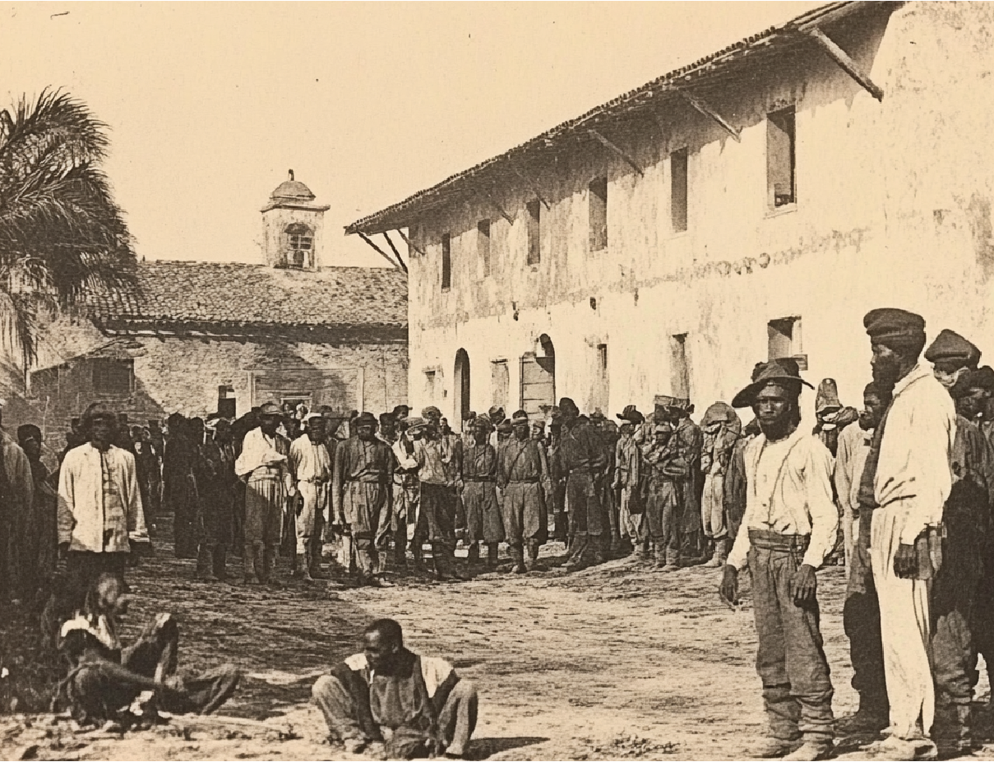
Abolition
of Slavery
Remind the audience about the
Emancipation Proclamation and
the 13th Amendment in 1865.

Slide 15
The Civil Rights Movement
(1950s-60s)
Major protests and legislative victories.

Slide 16
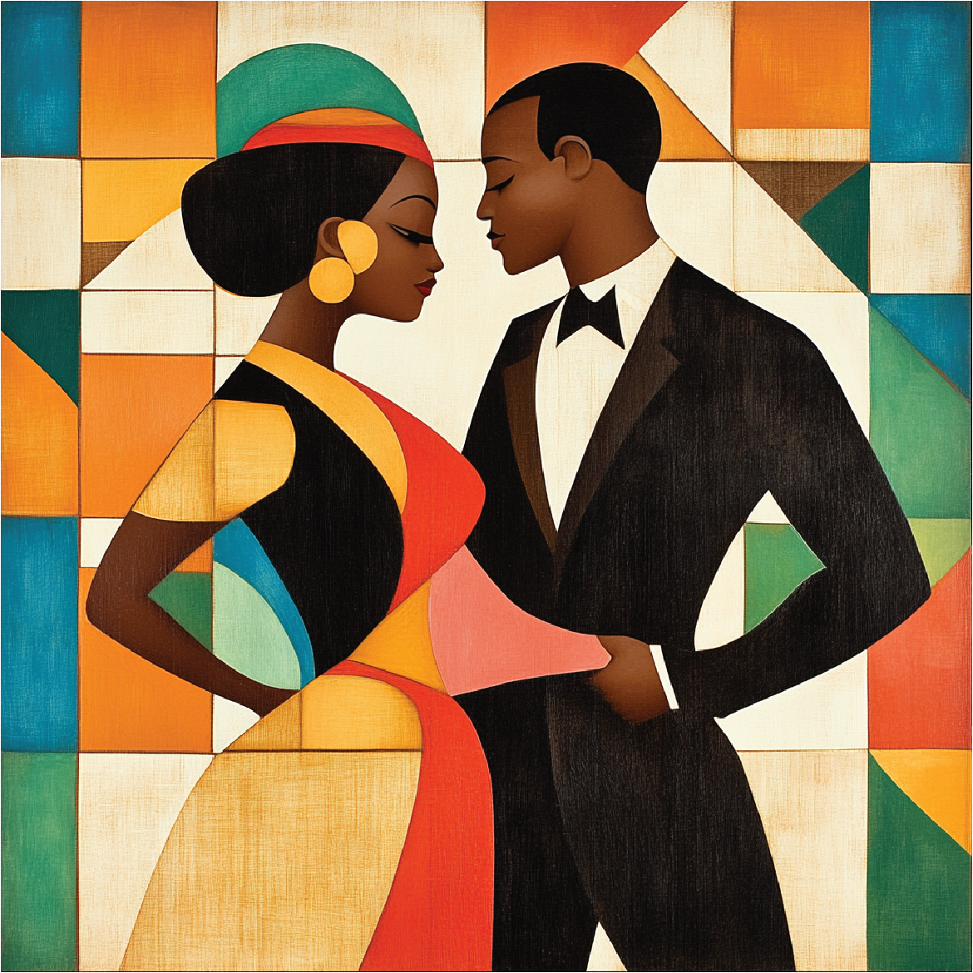
The Harlem
Renaissance
(1920s)
Tell us about the rise of black culture
during that period. Remember the most famous figures of art and literature.

Slide 17
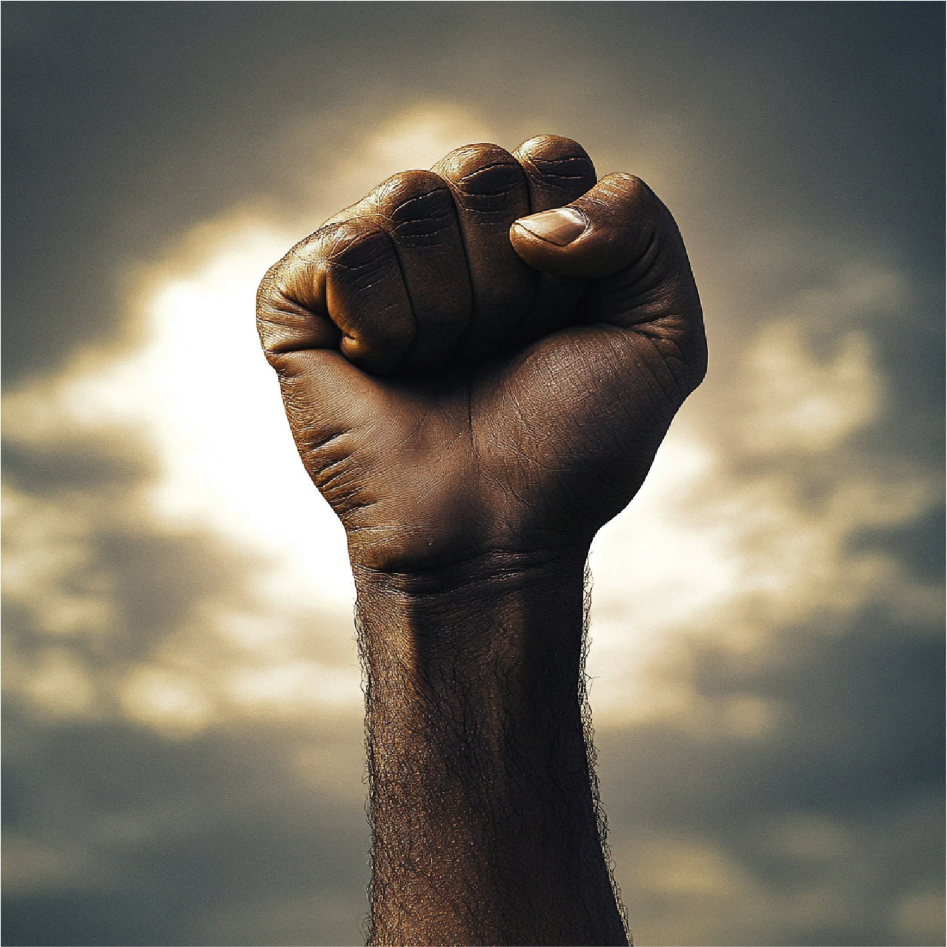
The Black Lives
Matter Movement
Focus on police reform and racial
justice since 2013.

Slide 18
Section 4:
CULTURAL
CONTRIBUTIONS

Slide 19
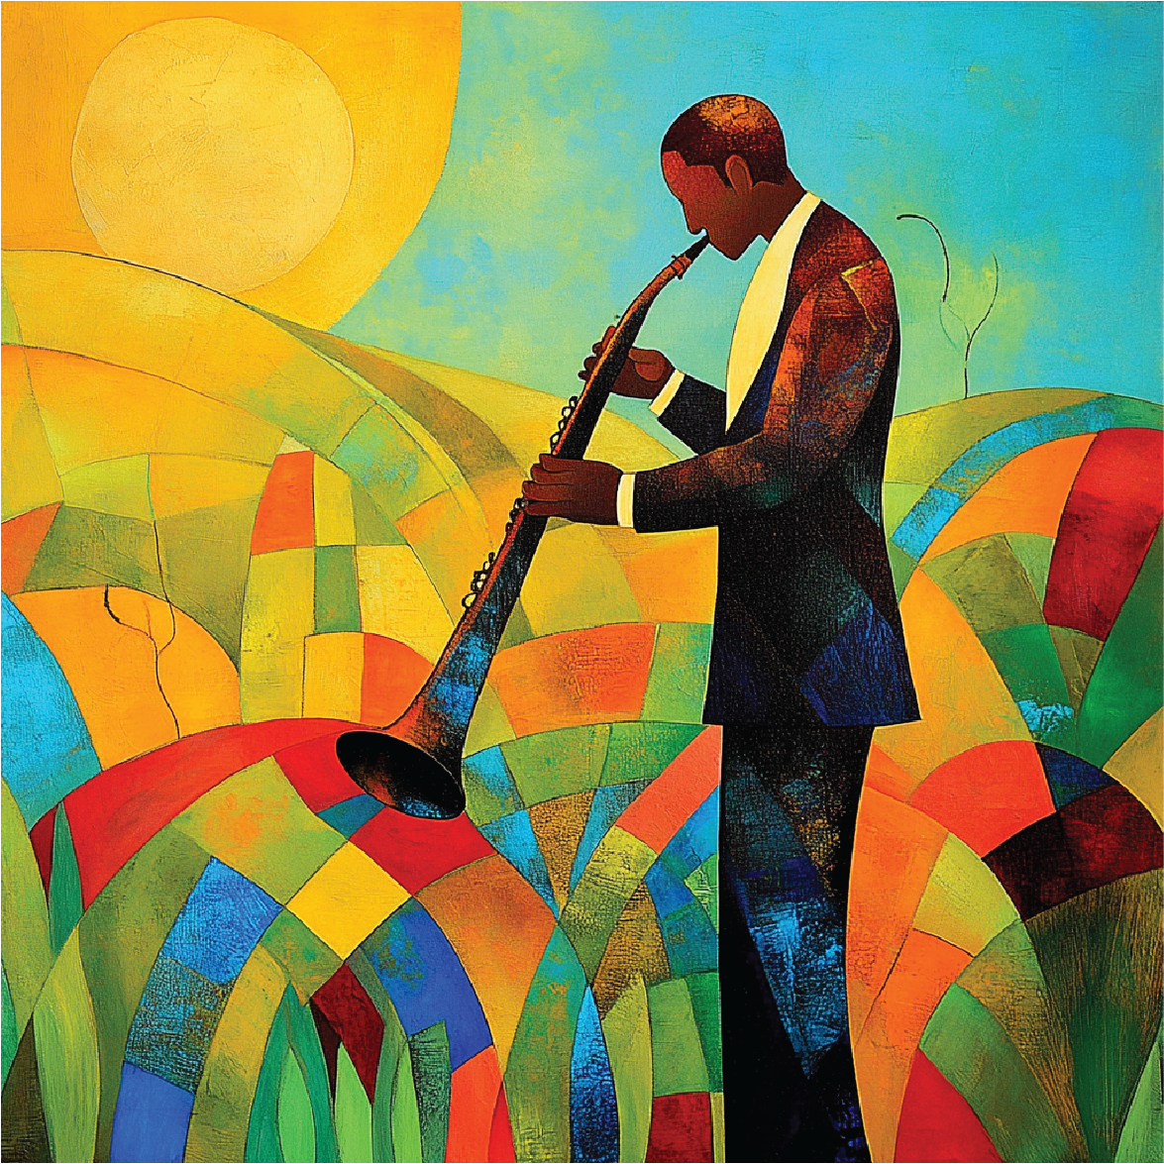
Contributions
to Music – Jazz
& Blues
Tell about the most famous
performers.

Slide 20
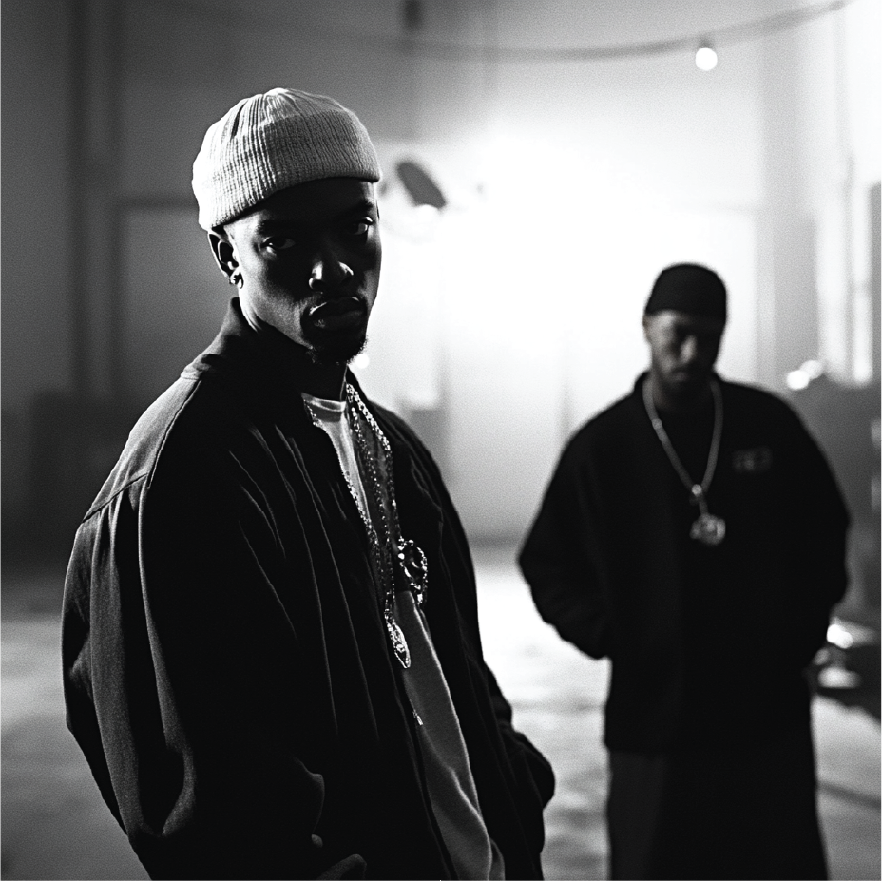
Hip-Hop and
Rap’s Global
Impact
Reminisce about the origins of hip-hop in the Bronx and the rise of influential artists.

Slide 21
Literature and
Storytelling
Tell the audience about the influence of Maya Angelou
and James Baldwin on modern thought.

Slide 22
Film and TV
Shaping
Representation
Talk about the achievements of Sidney Poitier and the various
media figures of today.

Slide 23
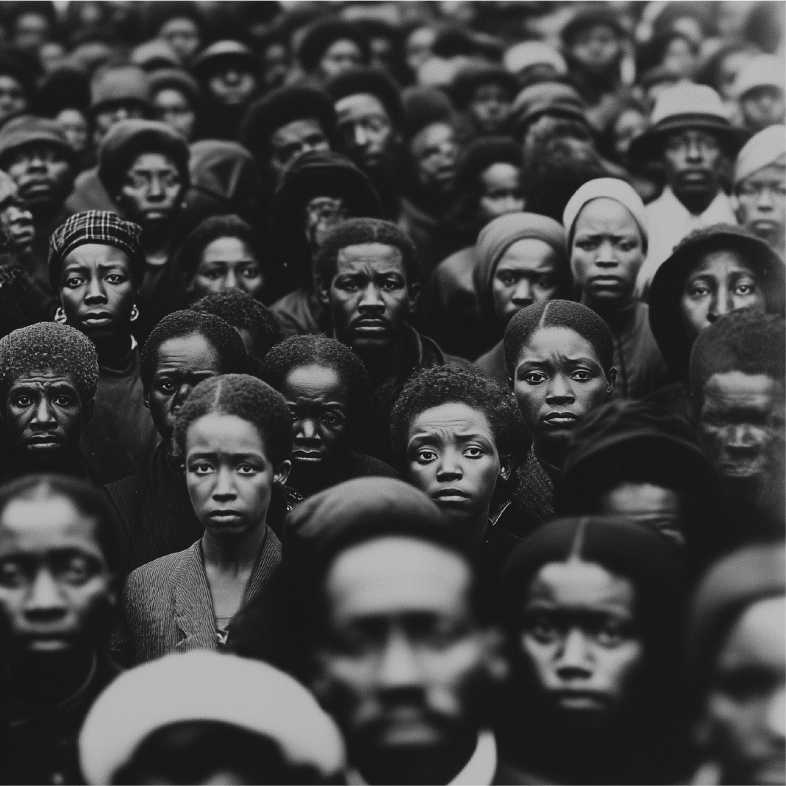
Section 5:
CHALLENGES
& VICTORIES

Slide 24
Systemic Racism
An Ongoing Struggle
Examples of economic and
social inequality.

Slide 25
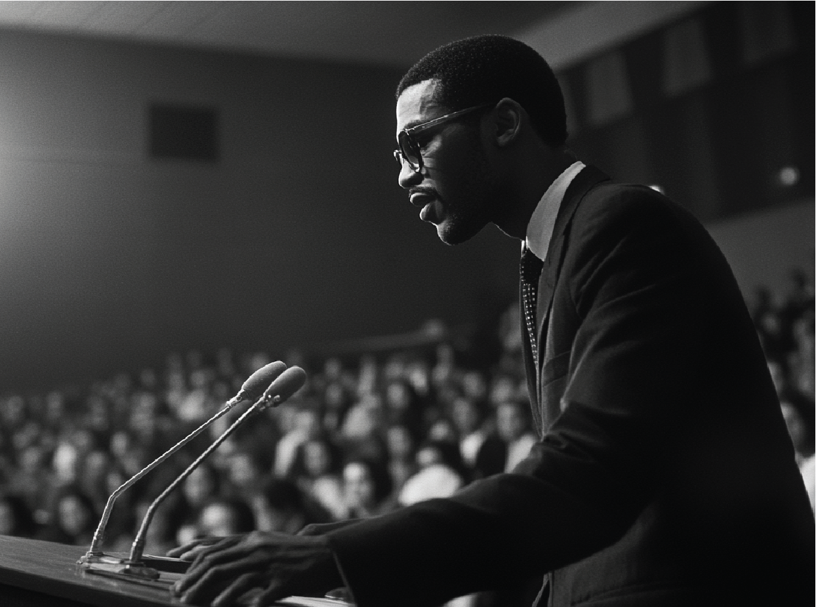
Legislative
Progress
Civil Rights Act of 1964 and Voting
Rights Act of 1965.

Slide 26
Educational Gaps and
Efforts to Close Them
Disparities in education and scholarships supporting change.

Slide 27
Section 6:
CELEBRATING BLACK
HISTORY MONTH TODAY

Slide 28
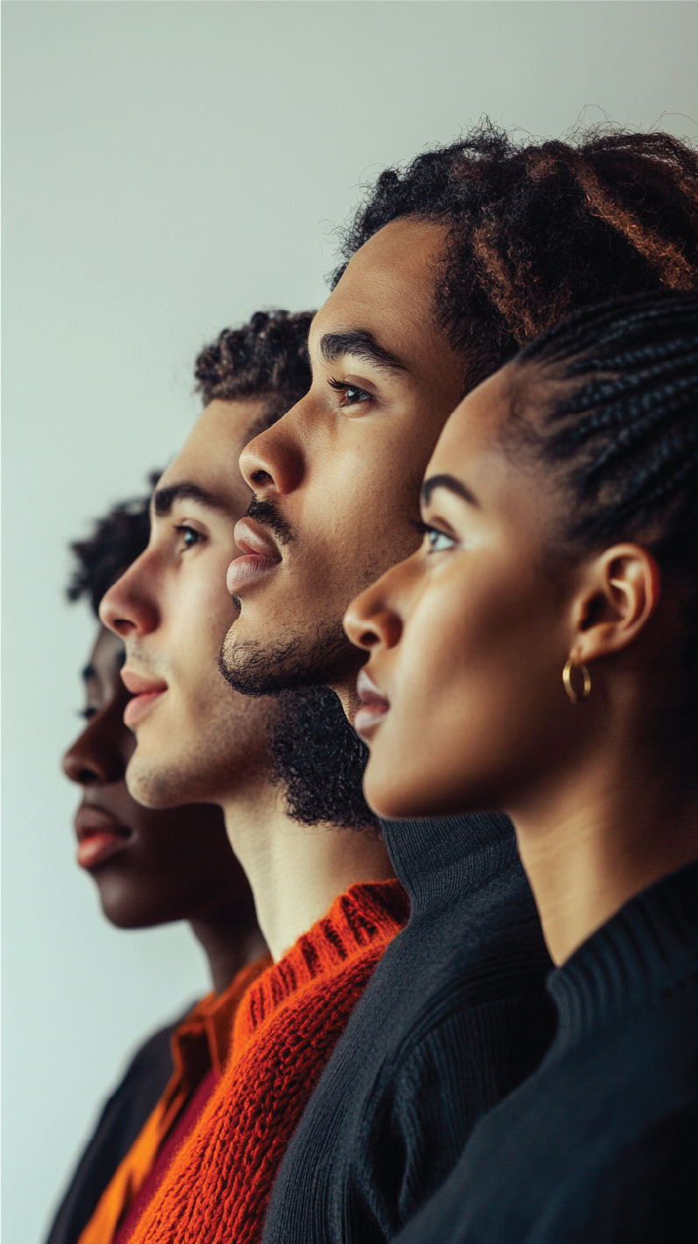
Annual Themes
and Their Meaning
“Black Resistance” (2023) or “Health
and Wellness” (2022).

Slide 29
How Schools Celebrate
Tell about the projects, collections and excursions to museums that
are held annually for schoolchildren.

Slide 30
Closing Remarks &
Key Takeaway
Inspirational quote:
“The time is always right to do what is right.”
– Martin Luther King Jr.

