Slide 1


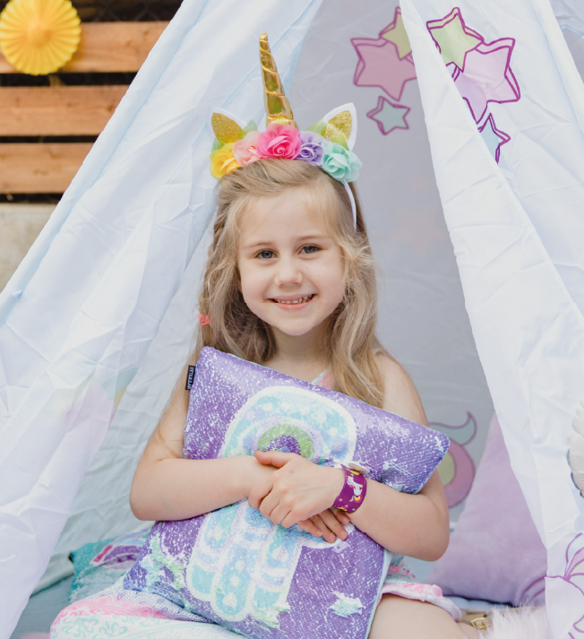


You’re invited to
CAROLINE’S
BIRTHDAY PARTY
12 JUNE 21:00
123 ANYWHERE ST., ANY CITY
RSVP JENNIFER AT (+1) 234-5678-901

