Slide 1

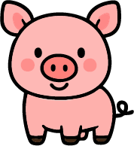




Name:
Date:
Section:
Teacher:
MATCH THE BEGINNING SOUND
Draw lines to matching the pictures and their beginning sounds.
U
R
B
L
K
P

