Slide 1
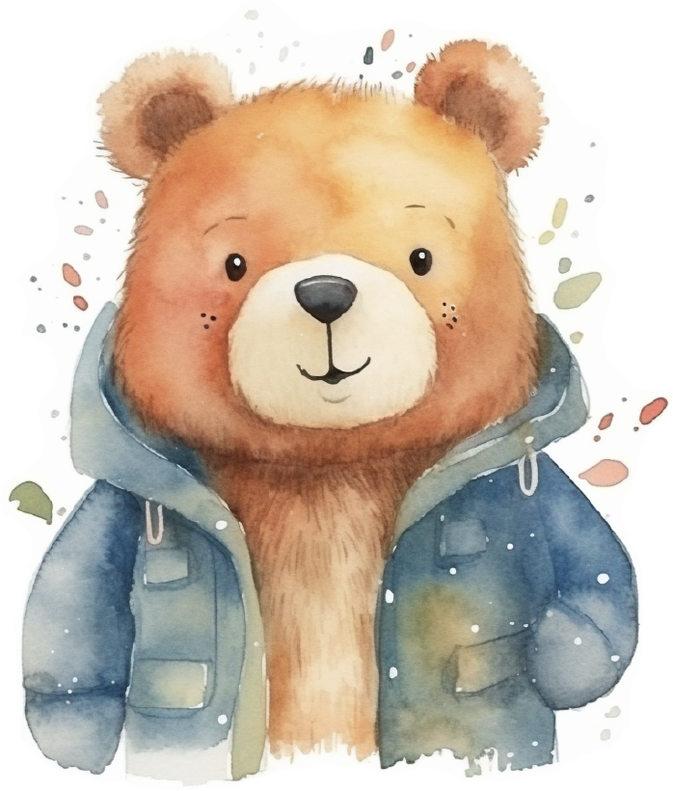
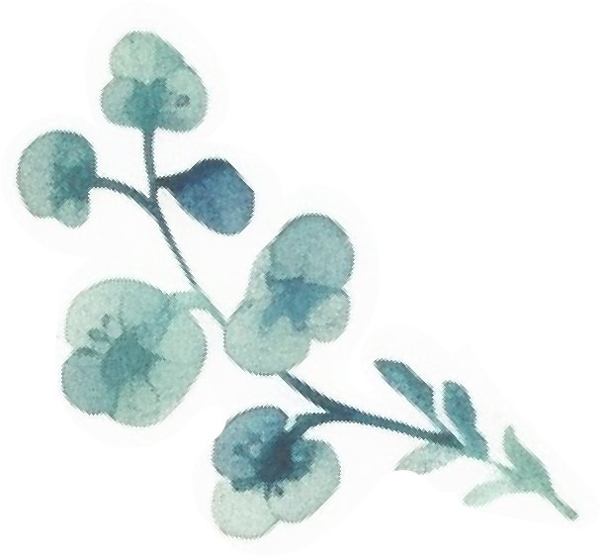
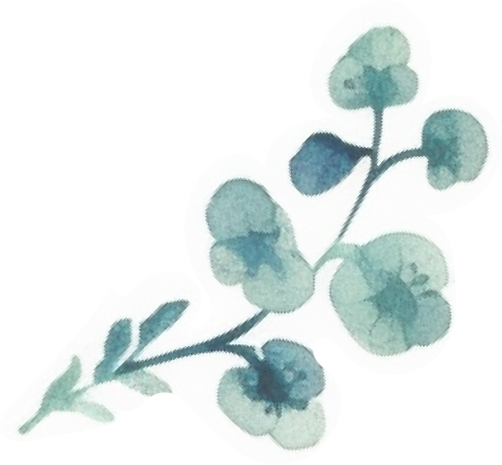
Before Baby Bucket List
• Take a romantic vacation.
• Host a party for friends.
• Spend time with family and loved ones.
• Pursue your hobbies.
• Try a new hobby.
• Get a full medical check-up.
• Consider your career.
• Attend a concert or exhibition.
• Travel the world.
• Attend various cooking classes and master classes.
• Visit an amusement park and ride the rides.
• Learn a new craft, such as sewing, knitting, or wood carving.
• Completely re read your favorite book or series
of books about motherhood.
• Go to a concert or festival to listen to your favorite musicians.
• Do renovation or upgrade your home.

