Slide 1
Katelin Adams
Spa Specialist

Slide 2
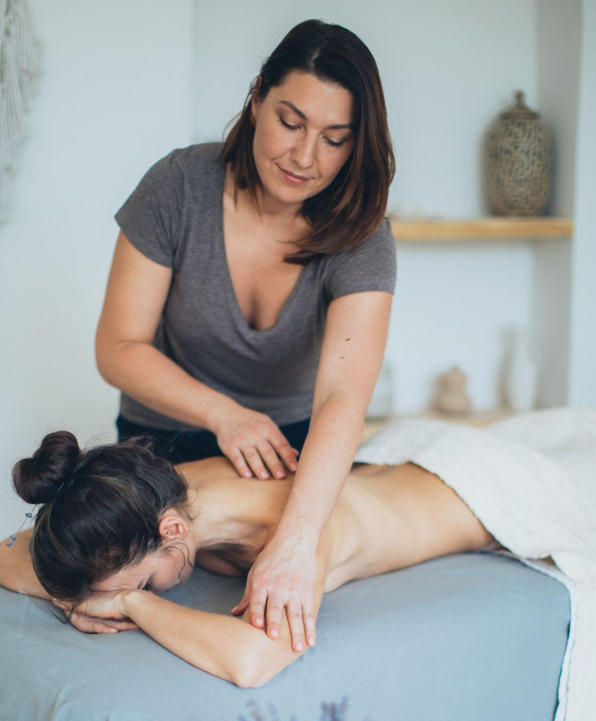
Katelin Adams
Spa Specialist
(123) 456-7890
Mail@domain.ltd
Domain.ltd
216 Cooper Fields
Lake Norbertoport 73878

Slide 3
Bonus logos

