Slide 1

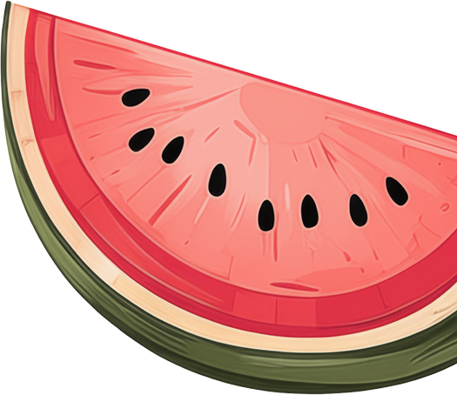
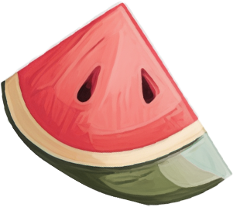

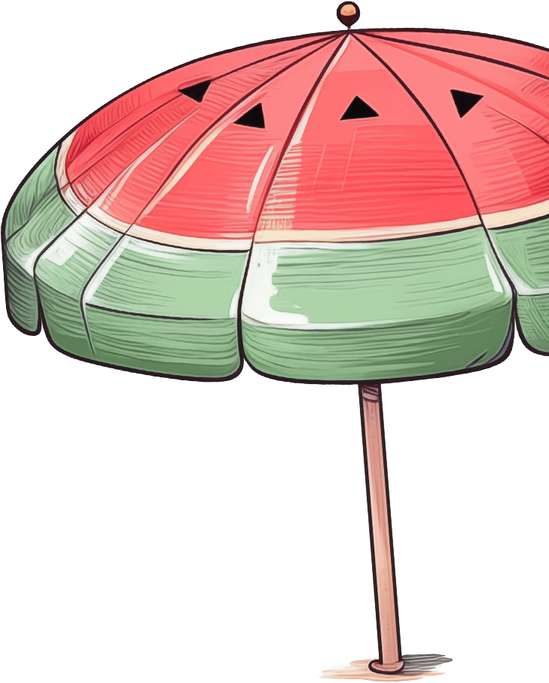
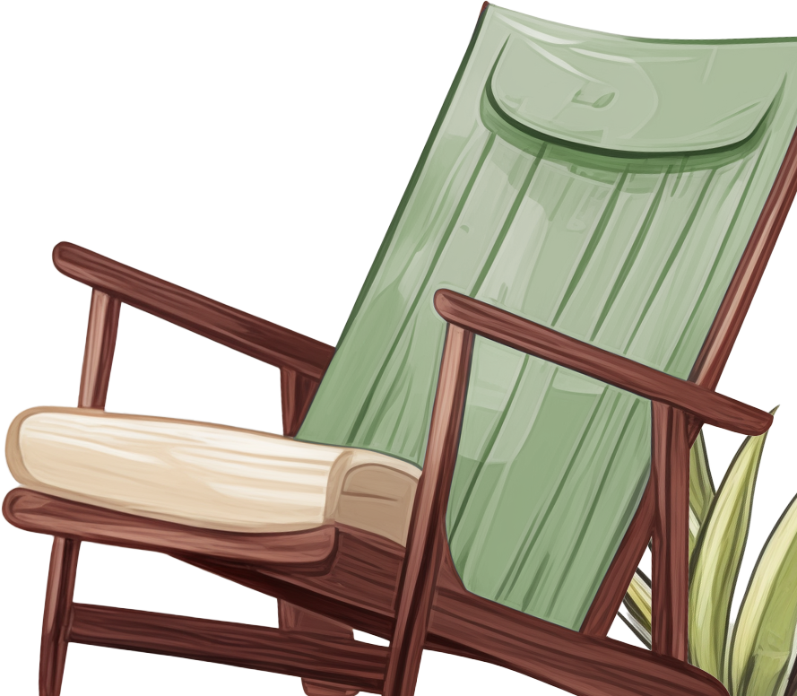
Beach Day
E S S E N T I A L S
Sun Protection:
Snacks:
Sunscreen
Water
Sunglasses
Snacks, Fruits, Nuts
Sun Hat
Cooler Bag with
Ice Packs
Lip Balm SPF
Reusable Water Bottle
Clothing:
Swimsuit
Entertainment:
Beach Cover-Up
Flip-Flops/Sandals
Beach Games
Rash Guard
Frisbee
Extra Change of Clothes
Sandcastle Tools
Kite
Relaxation:
Accessories:
Beach Chair
Phone Case
Beach Blanket
Power Bank
Portable Speaker
Portable Charger
Book/Magazine
Headphones
Beach Pillow
Cleanliness:
Portable Fan
Shelter:
First Aid Kit
Trash Bag
Beach Umbrella
Hand Sanitizer
Beach Tent
Baby Powder
Beach Canopy
Wet Wipes

