Slide 1
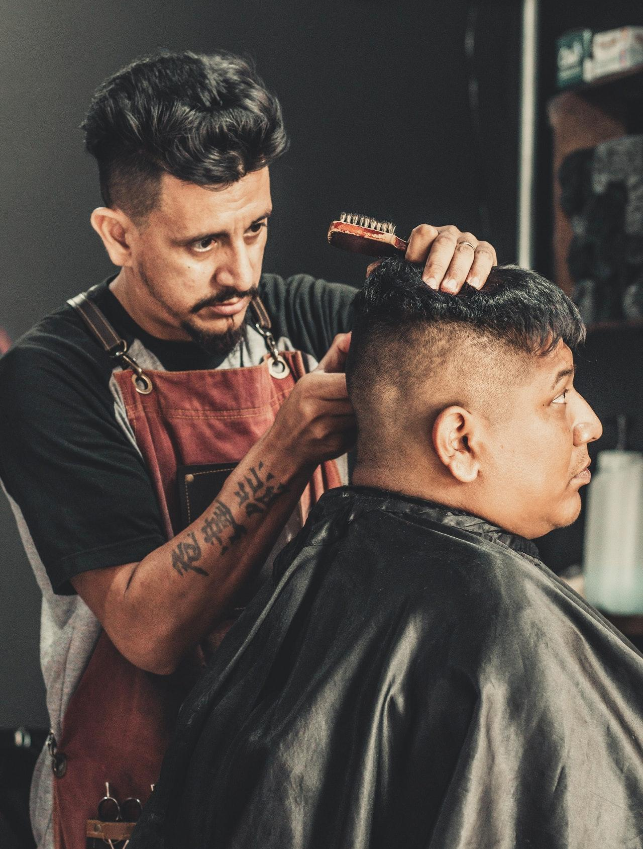
THE
BARBER
SHOP
50% discount for new customers

Slide 2
JOHATHAN
CHAMPLIN
Top Barber
Mobile: 012-345-6789
Website: example.com
Email: example@mail.com
Address: 5703 Rippin Crescent Apt

