Slide 1
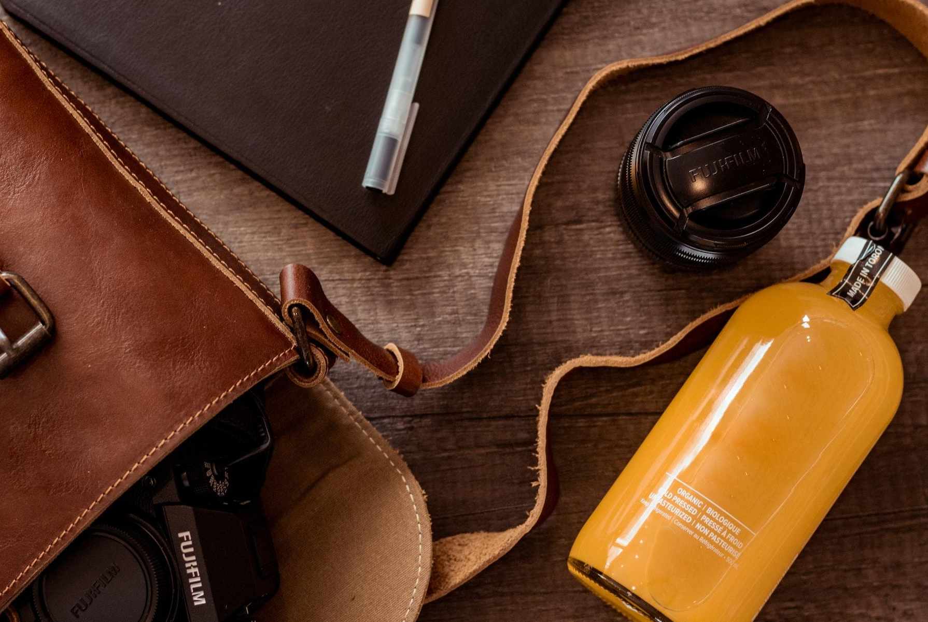
Bachelorhood
Bucket List
Travel to Japan
Learn how to bake
Go mountain hiking
Find a fun new hobby
Hug a stranger
Start a new business
Learn a new Language

