Slide 1
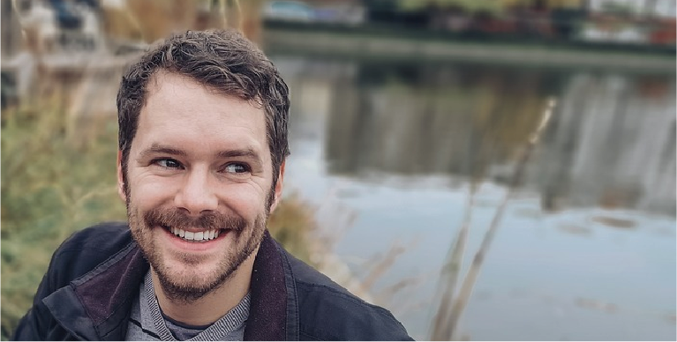
FELIX
VERHAEGHE
mail@domain.ltd
986-462-6578
Bilzen, 17218 USA
Behance.net/username
GRAPHIC ARTIST
EDUCATION
ABOUT ME
GRAPHIC DESIGN
School of Design/Providence/
United States/2004
Experienced, creative and motivated graphic designer with design solutions for his clients and stakeholders.
Over 10 year’s experience, as a Branding and Packaging Designer in the UK (and UAE) across a wide range of industries, including hospitality, retail, corporate and property.
Graphic Design HND
London College (UCK), London,
United Kingdom/2005
Graphic Design BA (Hons)
University of Derby, Derby,
United Kingdom/2008
WORK EXPERIENCE
Designed the layout and structure of advertisements based on market research, layout of classified pages, and special company's projects and/or their customers.
Worked within very tight deadlines
Created various original designs
Graphic Artist
2015 - 2017
COMPUTER/
GRAPHIC DESIGN SKILLS
Clearlink, Inc.
New York NY, USA
MS Office
Photoshop
Illustrator
Lightroom
Inkscape
Gimp
Canva
Collaborated with other teams and organization departments to develop and execute different sales tools.
Worked within very tight deadlines
Created various original designs
Developed and designed different logo
Using Microsoft Sharepoint
Identified flaws in existing designs
Graphic Artist
2017 - 2019
Clearlink, Inc.
New York NY, USA
HOBBIES
Created various original designs and/or revised existing design concepts for projects including Web Sites, Brochures, Ads, Catalogs, and Publications.
Worked within very tight deadlines
Created various original designs
Developed and designed different logo
Using Microsoft Sharepoint
Identified flaws in existing designs
Graphic Artist
2019 - 2021
Music
Travel
Photo
Clearlink, Inc.
New York NY, USA
Boating
Run
Film

