Slide 1
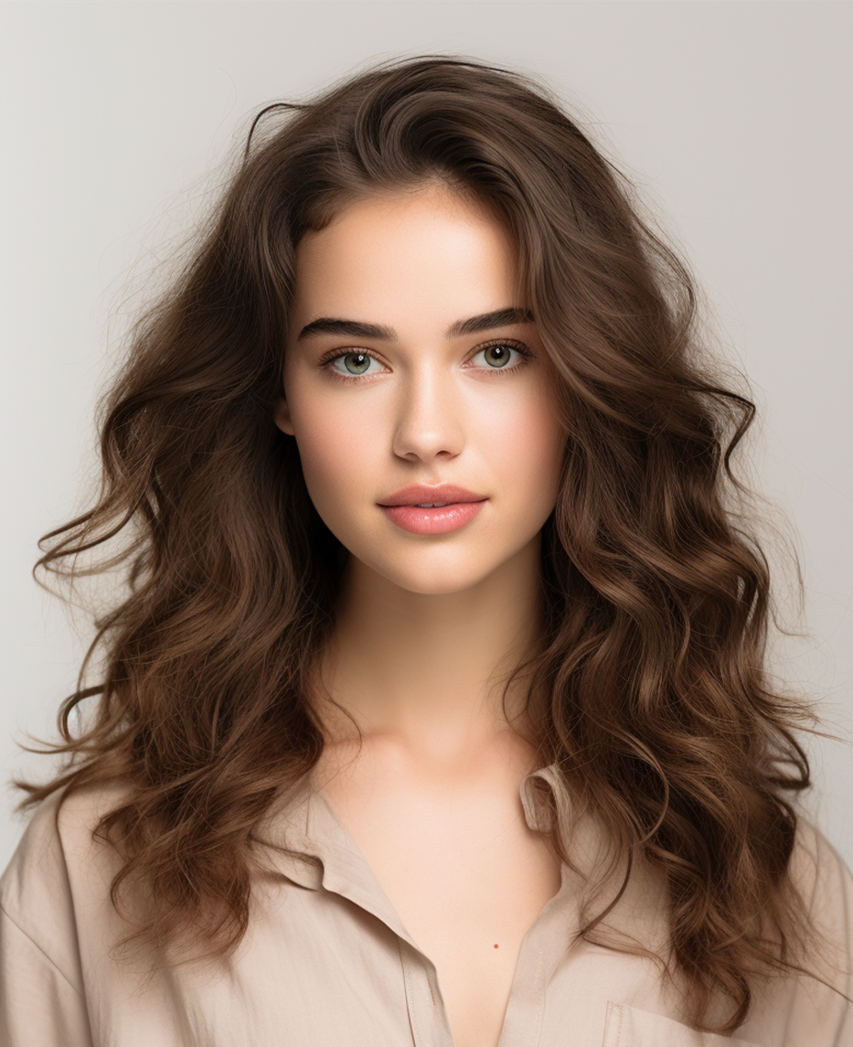
SERAPHINA JOHNSON
ART INSTRUCTOR
OBJECTIVE:
Passionate and versatile artist seeking opportunities to showcase creativity and contribute to artistic endeavors.
With a background in various mediums and a dedication to continuous learning, I aim to bring unique perspectives and innovative techniques to the art world.
CONTACT:
EDUCATION:
123 Artistic Avenue
Creative City, State, 56789
Bachelor of Fine Arts (BFA) in Painting and Sculpture, Art Institute of Creativity, Creative City, State, Graduated 20XX
(123) 456-7890
Master of Fine Arts (MFA) in Multimedia Art, Contemporary
Art College, Urban Center, State, Graduated 20XX
seraphina@example.com
seraphina@example.com
EXHIBITIONS:
"Explorations in Color and Form," Gallery XYZ, Urban
Center, State, January 20XX
SKILLS:
Proficient in various artistic mediums including painting, sculpture, multimedia art, and
digital illustration
"Sculpting Emotions," ArtSpace Collective, Metropolitan
Gallery, City, State, March 20XX
"Identity in Flux," Contemporary Art Museum,
Downtown Gallery, City, State, May 20XX
Strong understanding of art history, theory, and contemporary trends
SOLO SHOWS:
Excellent communication and interpersonal skills
"Ephemeral Realities: A Journey Through Imagination,"
Art Haven Gallery, Coastal Town, State, September 20XX
Proficient in Adobe Creative Suite and other digital art software
"Unveiling the Unseen: A Study in Perception," Gallery
123, Riverside City, State, November 20XX
REFERENCES:
GROUP SHOWS:
Available upon request.
"Ephemeral Realities: A Journey Through Imagination,"
Art Haven Gallery, Coastal Town, State, September 20XX

Slide 2
SERAPHINA JOHNSON
ART INSTRUCTOR
WORK EXPERIENCE:
Lead Artist, Spectrum Art Studios,
Urban Center, State, 20XX - Present
Conceptualize and execute original artwork for clients in
various mediums, including painting, sculpture, and
digital art.
CONTACT:
Manage a team of artists, providing guidance and
feedback to ensure projects meet client expectations
and deadlines.
123 Artistic Avenue
Creative City, State, 56789
Collaborate with clients to develop custom art
installations for commercial and residential spaces.
(123) 456-7890
seraphina@example.com
Art Director, Creative Visions Agency,
Metropolitan City, State, 20XX - 20XX
seraphina@example.com
Oversaw the creative direction of projects from concept
to completion, ensuring alignment with client objectives
and brand identity.
SKILLS:
Proficient in various artistic mediums including painting, sculpture, multimedia art, and
digital illustration
Developed and implemented innovative marketing
strategies to promote artwork and attract new clients.
Conducted artist workshops and training sessions to
foster skill development and inspire creativity among
team members.
Strong understanding of art history, theory, and contemporary trends
Art Director, Klein PLC Agency,
Virgiebury, State, 20XX - 20XX
Excellent communication and interpersonal skills
Monitored project creative direction from inception to fruition, ensuring harmony with client goals and brand essence.
Proficient in Adobe Creative Suite and other digital art software
Formulated and executed inventive marketing approaches to endorse artwork and engage prospective clients.
Facilitated artist workshops and training sessions to cultivate skill enhancement and ignite creativity within the team.
REFERENCES:
Available upon request.

Slide 3
SERAPHINA JOHNSON
ART INSTRUCTOR
Marcus Johnson
Position: CEO
Company: Johnson Enterprises
Phone: (555) 901-2345
Email: marcus.johnson@j.com
CONTACT:
123 Artistic Avenue
Creative City, State, 56789
Dear Marcus Johnson,
(123) 456-7890
I am writing to express my interest in the [Position Title] position advertised by [Company/Organization Name]. With a Bachelor of Fine Arts in Painting and Sculpture from the Art Institute of Creativity and a Master of Fine Arts in Multimedia Art from Contemporary Art College,
In my role as an Artist in Residence at Creative Minds Foundation, I had the opportunity to work closely with diverse groups of individuals, including students, fellow artists, and community members.
As an art instructor at Inspire Art Studio, I developed and implemented engaging lesson plans tailored to the unique needs of each student, fostering creativity and self-expression. I believe that my passion for art and dedication to helping others explore their creative potential make me a strong candidate for the [Position Title] position.
Thank you for considering my application. I look forward to the opportunity to discuss how my background, skills, and passion for art align with the needs of [Company/Organization Name]. Please find my resume attached for your review.
Warm regards,
seraphina@example.com
seraphina@example.com
SKILLS:
Proficient in various artistic mediums including painting, sculpture, multimedia art, and
digital illustration
Strong understanding of art history, theory, and contemporary trends
Excellent communication and interpersonal skills
Proficient in Adobe Creative Suite and other digital art software
REFERENCES:
Seraphina Johnson
Available upon request.

Slide 4
SERAPHINA JOHNSON
ART INSTRUCTOR
REFERENCES:
Emily Thompson
Position: Art Director
Company: Spectrum Art Studios
Phone: (555) 123-4567
CONTACT:
Email: emily.thompson@spectrumartstudios.com
123 Artistic Avenue
Creative City, State, 56789
Michael Rodriguez
Position: Gallery Curator
Company: Gallery XYZ
(123) 456-7890
Phone: (555) 234-5678
Email: michael.rodriguez@galleryxyz.com
seraphina@example.com
Rebecca Lee
seraphina@example.com
Position: Creative Director
Company: Creative Visions Agency
Phone: (555) 345-6789
SKILLS:
Email: rebecca.lee@creativevisionsagency.com
Proficient in various artistic mediums including painting, sculpture, multimedia art, and
digital illustration
Jonathan Wu
Position: Art Instructor
Company: Inspire Art Studio
Phone: (555) 456-7890
Email: jonathan.wu@inspireartstudio.com
Strong understanding of art history, theory, and contemporary trends
Sandra Davis
Position: Gallery Manager
Company: Aurora Gallery
Excellent communication and interpersonal skills
Phone: (555) 567-8901
Email: sandra.davis@auroragallery.com
Proficient in Adobe Creative Suite and other digital art software
Amanda Carter
Position: Director of Community Engagement
Company: Creative Minds Foundation
REFERENCES:
Phone: (555) 678-9012
Email: amanda.carter@creativemindsfoundation.com
Available upon request.

