Slide 1

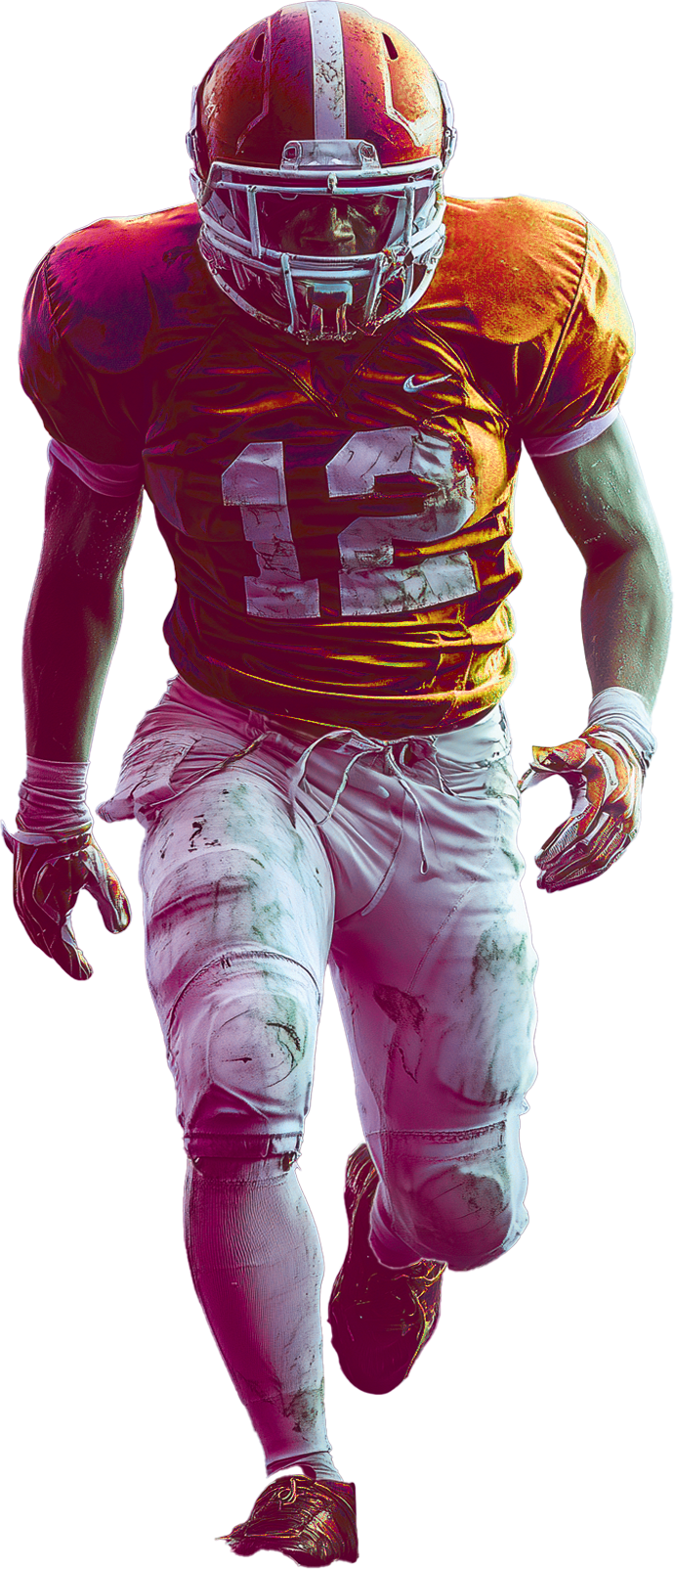

FOOTBALL
PLAY
OFF
JAN
4TH
SUN
8PM
TENNESSEE
TITANS
VS
DALLAS
COWBOYS
JACKSON’S PUB
123.456.7890 I 123 EAST SIDE I MIAMI, FL 12345
WWW.YOURPUBNAME.LTD

