Slide 1

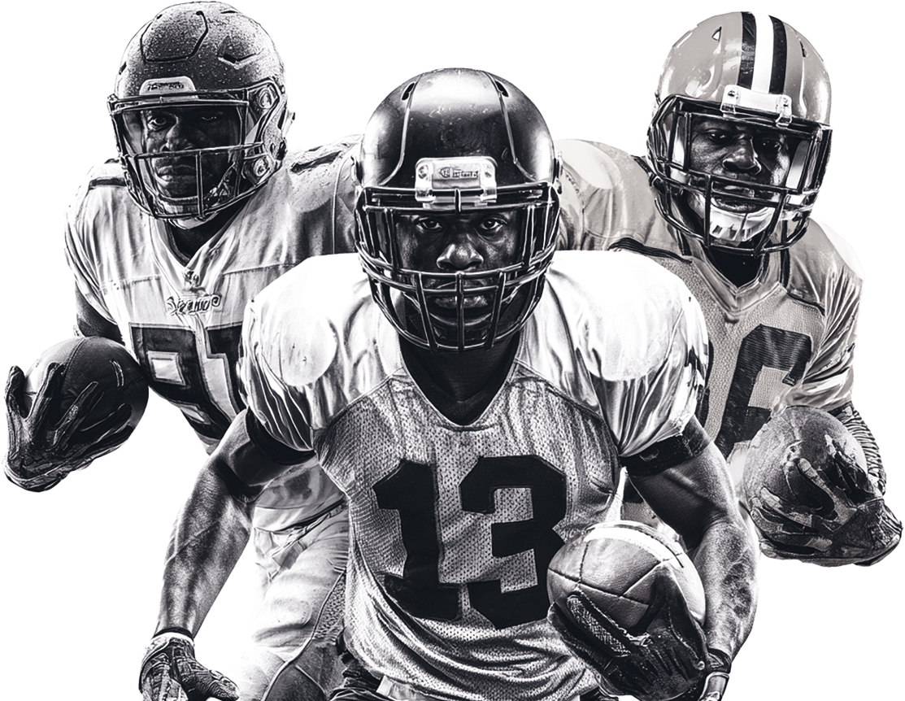
FOOTBALL
GAME
DAY
SATURDAY, JAN 19
DALLAS
COWBOYS
vs
GREEN BAY
PACKERS
@ JACKSON’S PUB
123.456.7890 I 123 EAST SIDE I MIAMI, FL 12345
WWW.YOURPUBNAME.COM

