Slide 1
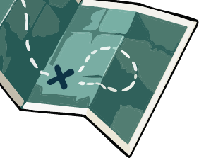
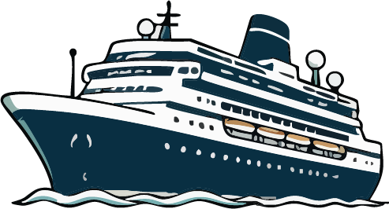





ALASKA CRUISE
Packing List
CLOTHING
Rainproof jacket with a hood
Fleece jacket for warmth
Water-resistant sneakers or boots
Sneakers/walking shoes
Hoodies, sweaters, cardigans
Pants/jeans/leggings/khakis
Exercise wear for fitness center
Baseball cap
Swimwear & pool cover-up
Flip-flops (for pool deck)
Jewelry & accessories
Fleece hat, gloves and scarf
Shawl or wrap for cool nights
Sleepwear
Short- and long-sleeve T-shirts and other casual tops
Casual dinner attire for non-elegant nights. Dresses, well-kept jeans, pants, and sweaters are common.
Formal attire and dress shoes for formal nights (2 nights on a 7-night cruise). Suit, shirt and tie or tux for men. Cocktail dress or dressy pants for women.
Undergarments
Socks (wool if hiking)
Activewear for excursions*
For active, water-based excursions, synthetic, moisture-wicking clothing is recommended. Avoid jeans and cotton.
ESSENTIALS
TOILETRIES
GEAR & ACCESSORIES
Passport or approved ID
Pen
Credit cards
Cruise line boarding
passes
Photo ID/driver's license
for port days (passport stays in the safe on the ship)
Cruise line luggage tags
Flight info and boarding passes
Lanyard for cruise card (optional – sold on board)
Sunscreen
Shampoo/conditioner
Makeup and skincare
Deodorant
Brush/comb
Toothpaste and toothbrush
Styling tools (flat iron, curling iron)
Hair dryer (most cruise lines have them, but they're low-powered)
Moisturizer
Body lotion
Lip balm
Razor
Phone chargers
Binoculars
Umbrella (optional)
USB charging hub
Lightweight backpack (water-resistant)
Magnetic hooks/clips for stateroom walls
Non-surge power strip (if allowed)
Water bottle or insulated coffee mug
Sunglasses
Small purse/clutch for dinners
Camera
Extra SD card
MEDICATION/FIRST AID KIT
Band-Aids and Steri-Strips
Cold medicine/cough drops
Hand sanitizing wipes
Pain relievers for adults and children
Cortisone or anti-itch cream/ointment
Bug repellent for activities such as zip-lining and bear-viewing tours
Antacid tablets
Tweezers

