Slide 1
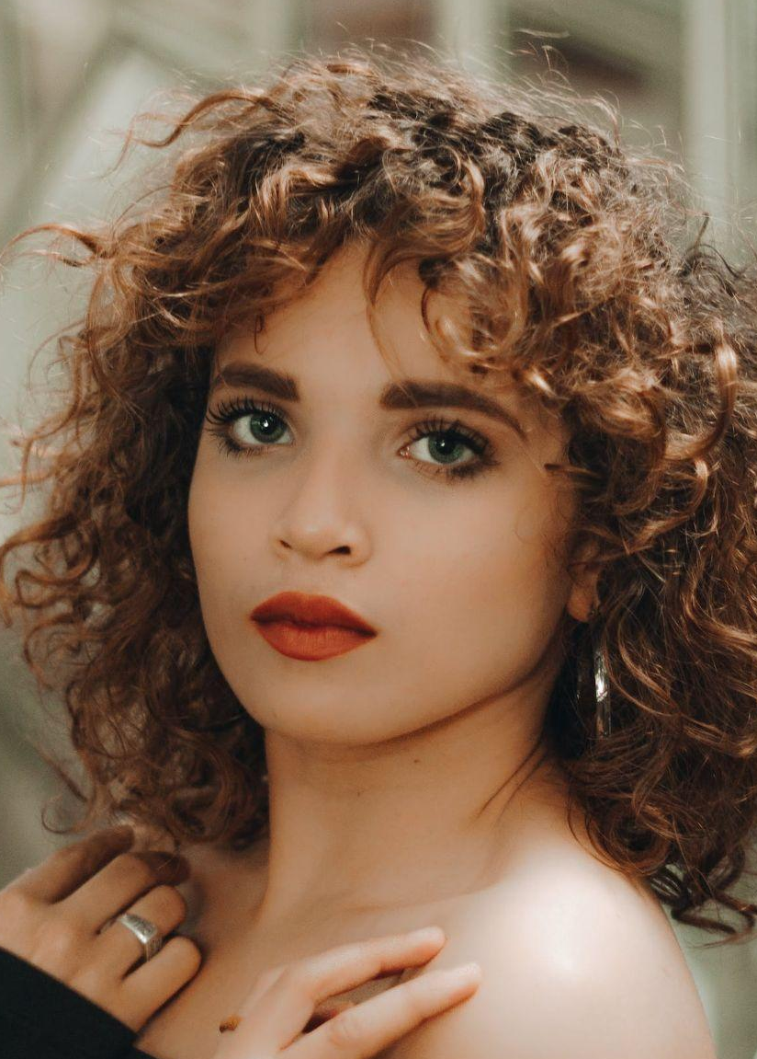
Kristina
Trantow
AEA / SAG - AFTRA
Elisabeth McDermott
Agency Camera & Action
T: 123-4567-890
M: myagent@mail.com
S: agencycameraaction.com
Height: 5.6 (168cm)
Weight: 121 lbs (55kg)
Eyes: Green
Hair: Brown
Theatre
OTHELLO
Desdemona
Washington Stage Guild
ANTIGONE
Antigone/Ismene
The Guildhall School-London
AS YOU LIKE IT
Rosalind
The Shakespeare Folger
HIPPOLYTUS
Aphrodite
The Getty Villa: Stephen Sachs
DREAM OF A COMMON LANGUAGE
Dolores
Theatre of the 1* Amendment
TALES OF INDIA
Buddha/Parvati
Smithsonian Institute
ROMEO & JULIET
Juliet
The Guildhall School-London
CIGARETTES & CHOCOLATE
Gemma
Potomac Theatre Project
ACTS OF DESIRE
Sayeda
Deborah Lawlor
Film & Television
CIGARETTES & CHOCOLATE
Gemma
Potomac Theatre Project
ACTS OF DESIRE
Sayeda
Deborah Lawlor
TALES OF INDIA
Buddha/Parvati
Smithsonian Institute

Slide 2
Kristina
Trantow
Elisabeth McDermott
Agency Camera & Action
T: 123-4567-890
M: myagent@mail.com
AEA / SAG - AFTRA
S: agencycameraaction.com
Education & Training
MASTER OF FINE ARTS, ACTING
Brown University | Providence, Rhode Island
BACHELOR OF ARTS, THEATER ARTS
Yale University | New Haven, Connecticut
Skills
DANCE
Ballet Dance (Proficiency) , Ballroom Dance (Proficiency), Tango (Proficiency)
SINGING
Musical Theatre, Operatic, Rap, Rock/Pop
LANGUAGES
English (Proficiency), Spanish (Proficiency), French (Proficiency)
ACCENTS
American English, British English, South African English, French, Spanish
ADDITIONS
Martial Arts, Cheerleading, Painting, Playing Piano, Swimming
References
KRYSTAL FRANECKI
ARACELI GREENFELDER
JUSTICE TREMBLAY
Lebo Theatre
Sawayn-Carroll Agency
Hermann and Sons Theatre
Decorator
Professional agent
Professional actor
T: 123-4567-890
T: 123-4567-890
T: 123-4567-890
E: Krystal@mail.com
E: Araceli@mail.com
E: Justice@mail.com
JEVON HEIDENREICH
BRUCE FEENEY
Lebo Theatre
Hermann and Sons Theatre
Professional actor
Professional agent
T: 123-4567-890
T: 123-4567-890
E: Jevon@mail.com
E: Bruce@mail.com

Slide 3
Kristina
Trantow
Elisabeth McDermott
Agency Camera & Action
T: 123-4567-890
M: myagent@mail.com
AEA / SAG - AFTRA
S: agencycameraaction.com
Cover Letter
DECEMBER 21 / 2025
Mrs. Lawrence Larson
1694 Breezewood Court
Lebo, Kansas, 66856
123-4567-890
Larson@mail.com
Dear Mrs. Lawrence Larson
A cover letter introduces yourself to the employer and highlights your relevant qualifications and experiences. Its purpose is to convince the employer that you are the right candidate for the job by demonstrating your enthusiasm and unique skills. While a cover letter is not always required by every employer, it is highly recommended to include one as it can increase your chances of being invited for an interview. Overall, it is a crucial part of a job application that can help you stand out from other candidates.
Begin with an opening paragraph: Introduce yourself and explain why you are interested in the job. Mention how you found out about the job opening and any connections you have to the company.
Highlight your qualifications: Use the body of the letter to explain how your skills and experiences make you a strong candidate for the job. Be specific and give examples of times when you demonstrated these skills.
Show your enthusiasm: In the closing paragraph, express your excitement about the opportunity to join the company and contribute to its success. Thank the employer for considering your application and include your contact information.
Use a professional sign-off like "Sincerely" or "Best regards,” followed by your name.
Before sending your cover letter, make sure to proofread it carefully for spelling and grammar errors. You may also want to have a friend or mentor review it to get feedback and make sure it is clear and concise.
Kristina Trantow
Sincerely,

