Slide 1
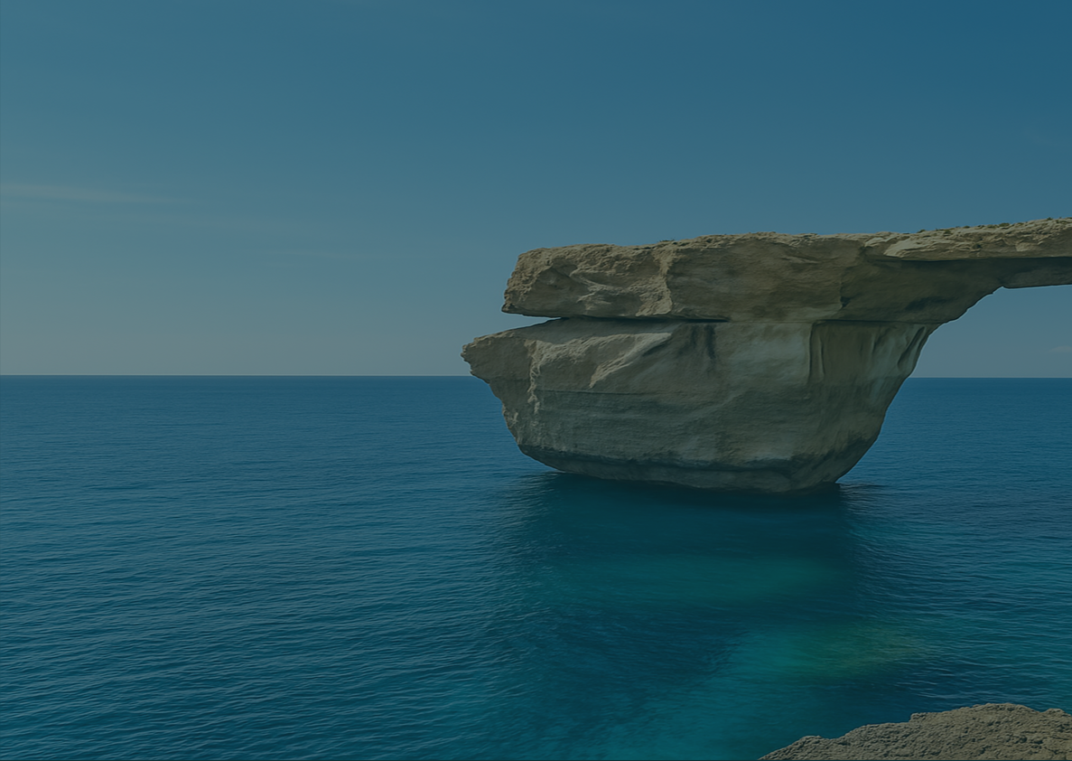
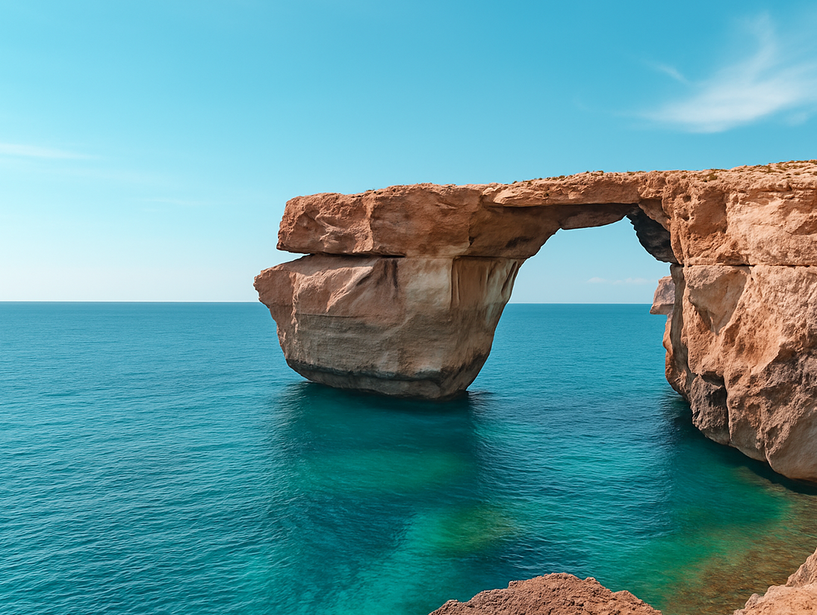

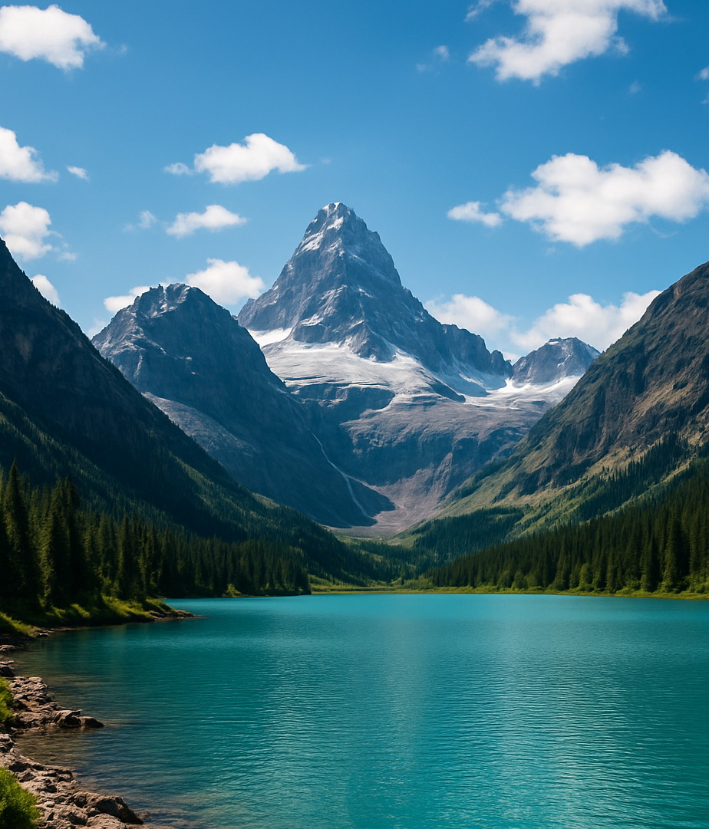
Your story starts here
TRAVEL
Wander
& Discover
Where mountains touch the clouds and the sea whispers freedom.
Get in Touch
Step away from routine and rediscover your love for adventure. Whether you dream of mountain trails or turquoise coastlines, we’ll create a journey that fits your rhythm and passions.
+44 123 456 7890
hello@wanderdiscover.ltd
wanderdiscover.ltd
12 Green Hill Avenue,
London, UK
Where mountains touch the clouds and the sea whispers freedom.
From sunrise hikes to sunset cruises – your story starts here.
Ready to explore?
Let’s plan your perfect trip.
www.wanderdiscover.ltd

Slide 2
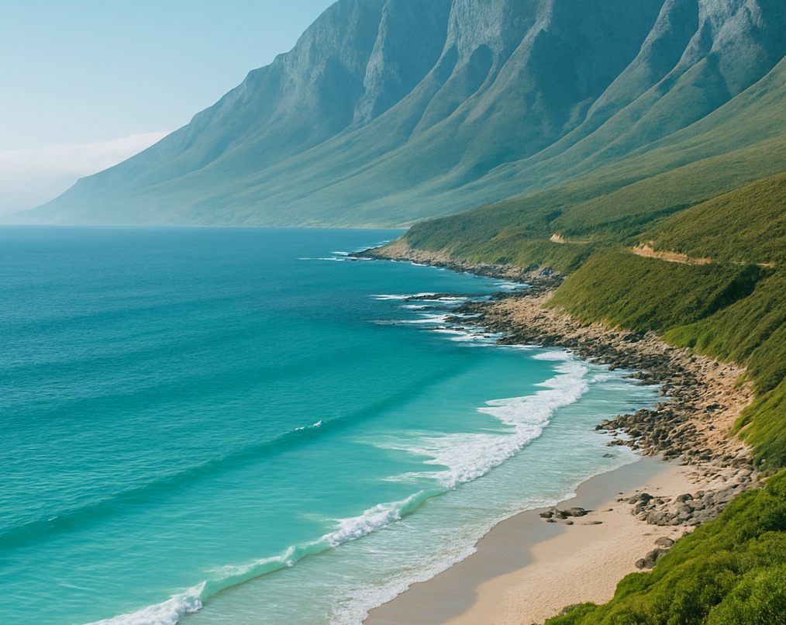

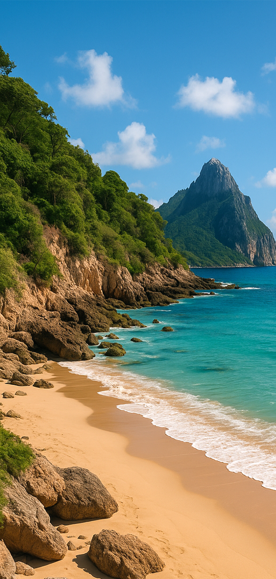
SEA ESCAPES
Mountain Journeys
Our Top
Destinations:
Swiss Alps
hike through breathtaking trails and crystal-clear lakes surrounded by nature
Amalfi Coast
colorful villages, sea breeze, and Mediterranean cuisine
all around you
The Dolomites
mountain magic with luxury spas, hidden beaches, and medieval charm
Santorini
white cliffs, blue domes, and endless sunsets over calm seas with warm evening lights
Why Choose Us
Over 10 years of travel experience
Trusted local partners in 15 countries
Sustainable and responsible tourism practices
Custom itineraries for solo, couple,
or group travelers
Stress-free planning from start to finish
Let’s Make It Happen
Tell us what you love — mountains,
sea, or both — and we’ll create a tailor
made adventure you’ll never forget.
Guided treks with professional mountain guides

