Slide 1

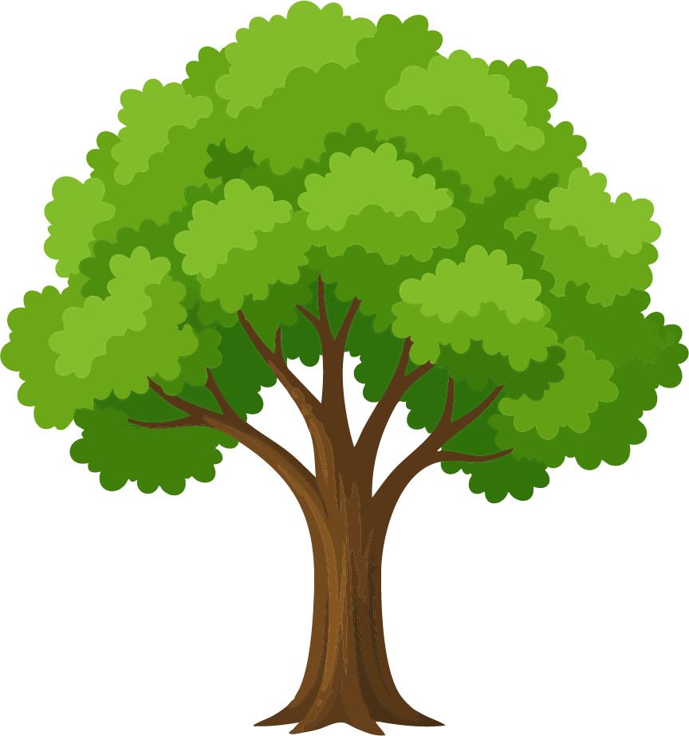

4 GENERATION FAMILY TREE
Great-grandmother
Great-grandmother
Grandmother
Grandmother
Great-grandfather
Great-grandfather
Mother
Father
Great-grandmother
Great-grandmother
Grandfather
Grandfather
Me
Great-grandfather
Great-grandfather

