Slide 1

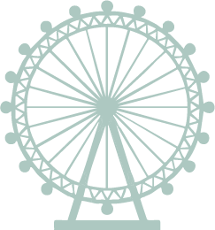
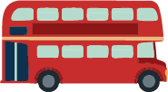
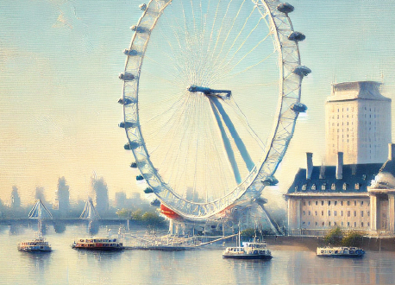
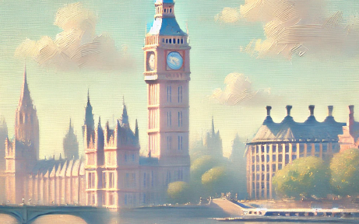
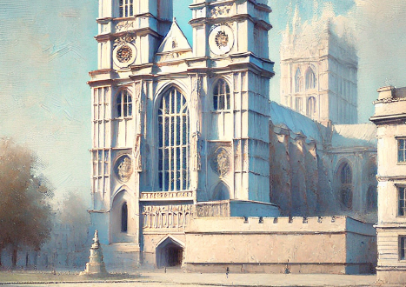
LONDON
Itinerary
Tower Bridge
Tower of London
St Paul's Cathedral
London Eye
Palace of Westminster
Big Ben
Westminster Abbey
Changing of the Guard
Buckingham Palace
DAY 1
Hyde Park
Speakers' Corner
Piccadilly Circus
Leicester Square
The National Gallery
Trafalgar Square
St Dunstan-in-the-East
Covent Garden
Soho
DAY 2
Shakespeare's Globe Theatre
Victoria and Albert Museum
The British Museum
Notting Hill
Portobello Road Market
Kensington Gardens
DAY 3

