Slide 1
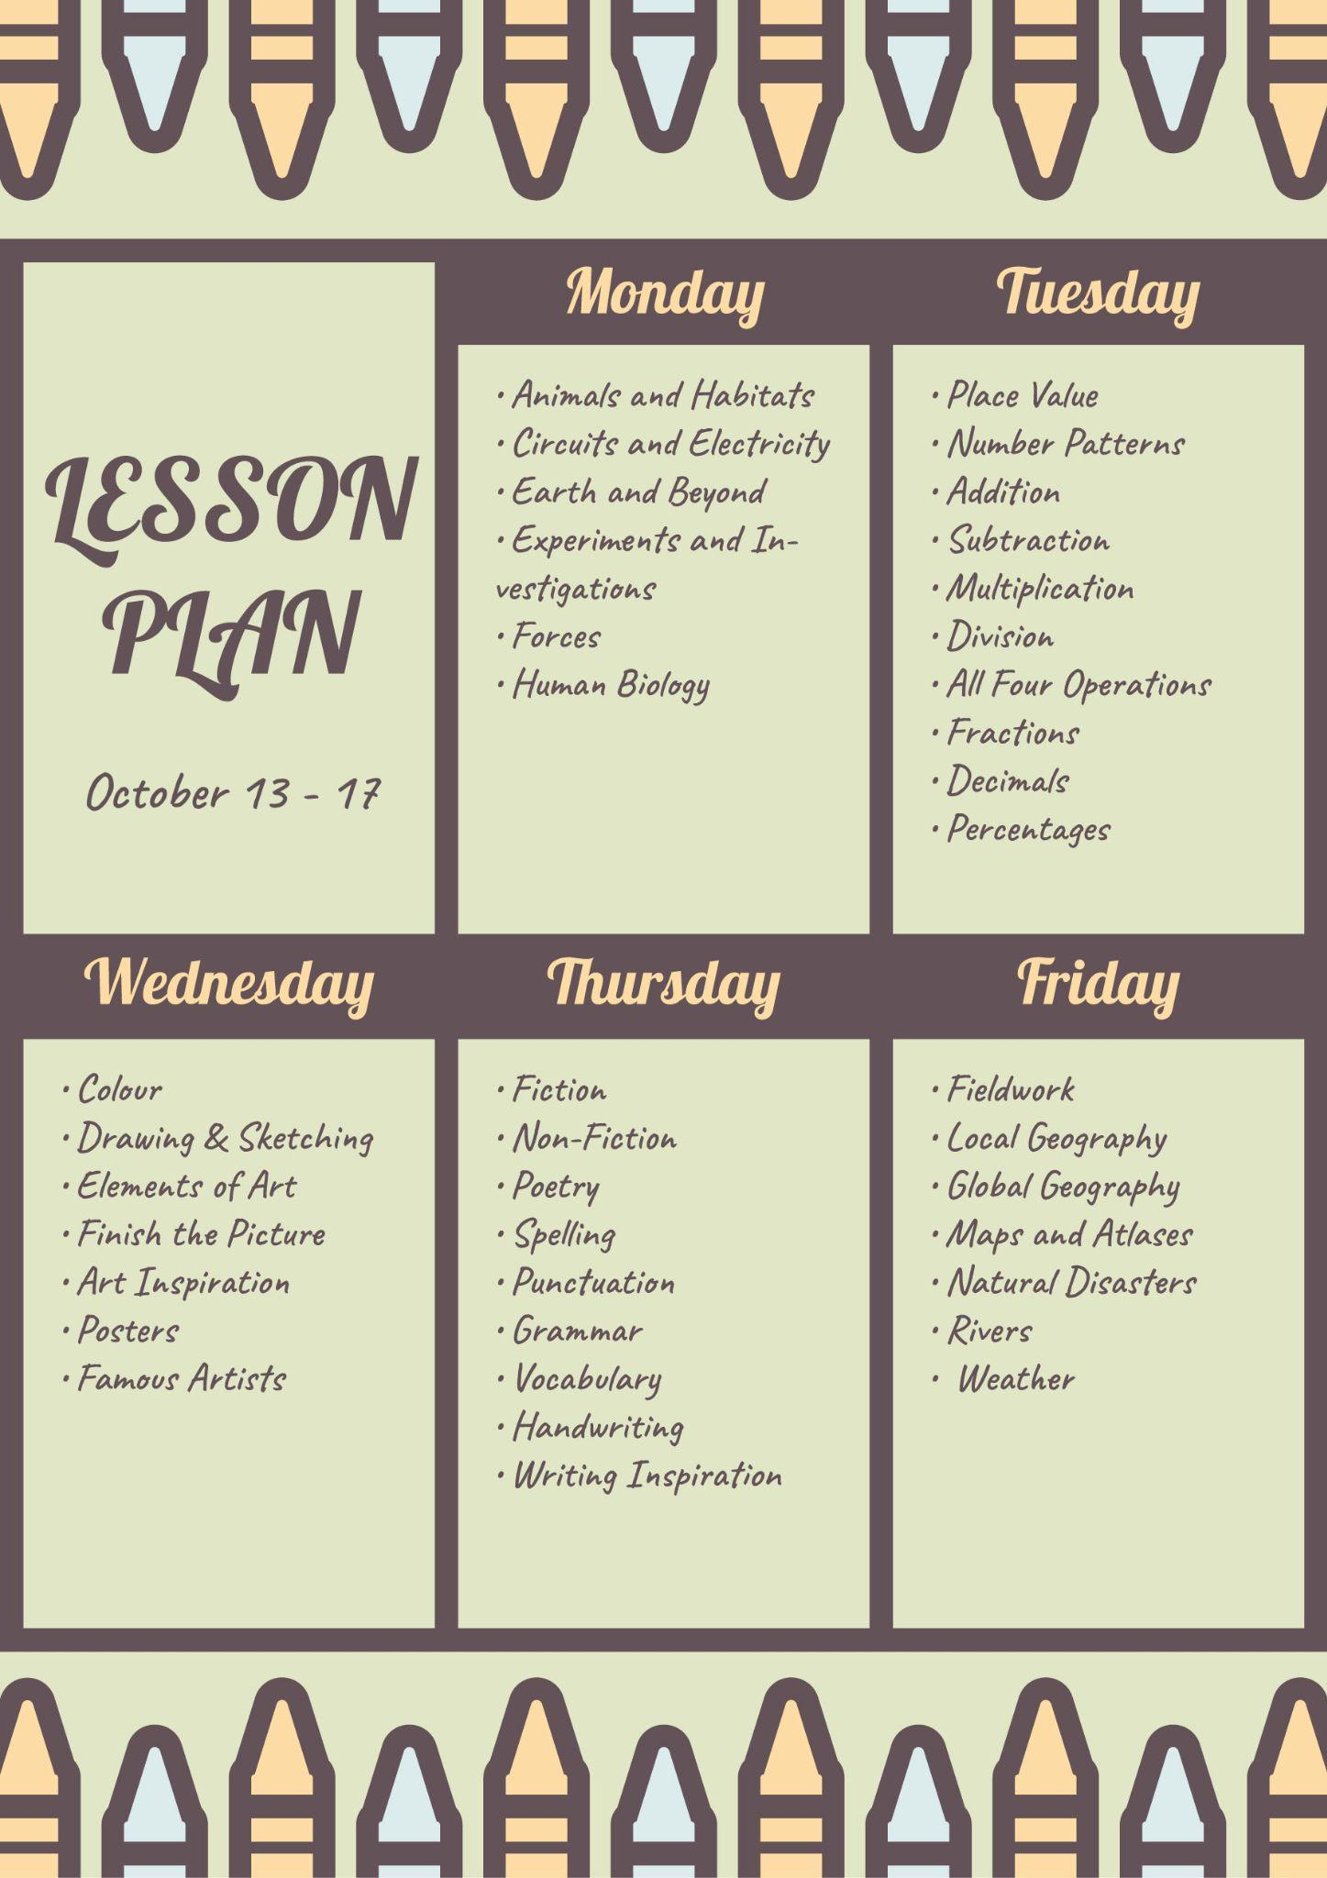


Monday
Tuesday
• Animals and Habitats
• Circuits and Electricity
• Earth and Beyond
• Experiments and Investigations
• Forces
• Human Biology
• Place Value
• Number Patterns
• Addition
• Subtraction
• Multiplication
• Division
• All Four Operations
• Fractions
• Decimals
• Percentages
LESSON
PLAN
October 13 - 17
Wednesday
Thursday
Friday
• Colour
• Drawing & Sketching
• Elements of Art
• Finish the Picture
• Art Inspiration
• Posters
• Famous Artists
• Fiction
• Non-Fiction
• Poetry
• Spelling
• Punctuation
• Grammar
• Vocabulary
• Handwriting
• Writing Inspiration
• Fieldwork
• Local Geography
• Global Geography
• Maps and Atlases
• Natural Disasters
• Rivers
• Weather

